Slide 1
Introduction to Stata
Spring 2017

Slide 2
Objectives
Introduction to the Stata system and Stata language
Learn to…
  view and save data
  create and manipulate variables
  append and merge data
  collapse data

Slide 3
Survey results

Slide 4
The Stata screen
General commands (file, edit, etc.) at very top of screen allow you to generate commands
Variables box (right side) - lists all variables
Command box (at bottom) - where you write commands
Review box (left side) - accumulates all commands run in a session
Results box (center) show all results as produced

Slide 5
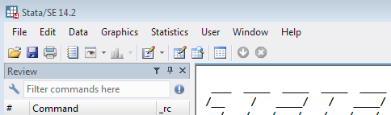
The Do file
Where you will write and save all of your code
Set up the Do file so that the entire program can be run all at once (i.e., batch mode)
To open a Do file, go to File → Do OR click here:
Within a Do file, you can start a new program or open an existing program

Slide 6
Basics of programming in Stata
Syntax matters
  Any code that isn’t exactly right won’t work (at least not the way you want)
Capitalization matters
  For commands – Stata wants you to uses lower case
  For variables – City, city, and CITY can all be different variables
    It’s best to stick with a consistent naming method for your variables (e.g., use lowercase for everything)
Stata defaults each command to one line, unless you tell it otherwise
  Tell it otherwise by adding /// to the end of a line (led by a space “ ///”)
Annotate your program by adding commented-out text
  To comment out a line, start it with *
  To comment out multiple lines, start with /* and end with */

Slide 7

Getting your data
You can open your data a number of ways:
  In the main Stata screen: File → Open
  Use the folder:
  Drag the .dta file into the program
  USE CODE
    Basically, always use code – though sometimes there can be good reason to use another method (e.g., to determine the location on your computer)

Slide 8
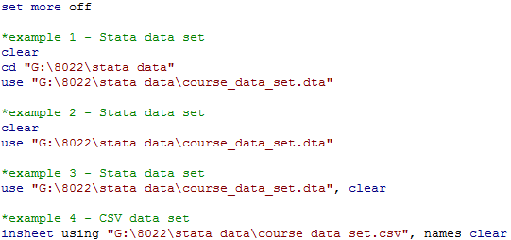
Getting your data
The first code of every program
Multiple ways of pulling in your data:
“clear” removes any data you are working with in Stata
“cd” (change directory) tells Stata the default place to look for and save data sets

Slide 9

Working with data
Step 1: Start a Do file, upload your data, and look at your data
Two main ways to browse your data
  Click here:
  Use the command “browse”
    The browse command lets you pick which variables you want to see, in which order For example:

Slide 10
Working with data
Keep looking at your data, but by commands
  describe (or desc) - to list variables, give N
  codebook - overall summary of variables
    For specific variables: codebook variablename
  summarize (or sum) - summary statistics
    Use option “detail” to get more summary statistics
    sum variablename, detail
  tabulate (or tab)
  tab variablename1
  cross tabulations
  tab variablename1 variablename2
  tabulate multiple variables (individually, rather that cross)
  tab1 variablename1 variablename2

Slide 11
Working with Data (example output)
. describe yot_0_to_3
storage display value
variable name type format label variable label
------------------------------------------------------------------------------------------------------
yot_0_to_3 byte %8.0g
. codebook yot_0_to_3
------------------------------------------------------------------------------------------------------
yot_0_to_3 (unlabeled)
------------------------------------------------------------------------------------------------------
type: numeric (byte)
range: [0,1] units: 1
unique values: 2 missing .: 0/36
tabulation: Freq. Value
28 0
8 1
. sum yot_0_to_3
Variable | Obs Mean Std. Dev. Min Max
-------------+--------------------------------------------------------
yot_0_to_3 | 36 .2222222 .421637 0 1
. tab yot_0_to_3
yot_0_to_3 | Freq. Percent Cum.
------------+-----------------------------------
0 | 28 77.78 77.78
1 | 8 22.22 100.00
------------+-----------------------------------
Total | 36 100.00

Slide 12
Working with data
Stata can also generate some simple tables
For example:
Looking at the N and mean of two variables by a third variable:
. table yot_0_to_3, c(n math_major mean math_major n mathcoursetaught_08 mean mathcoursetaught_08)
--------------------------------------------------------------------------
yot_0_to_ |
3 | N(math_m~r) mean(math_m~r) N(mathc~08) mean(mathc~08)
----------+---------------------------------------------------------------
0 | 28 .285714 12 .833333
1 | 8 .25 3 1.33333
--------------------------------------------------------------------------
  Can also gen standard deviation, standard error, median, min, max, etc.

Slide 13
Dictionary of (some) symbols
Writing code in Stata is nothing but writing logical statements and utilizing pre-existing commands
Syntax meaning:
= → Equals ! → Does not if → If
> → Greater than < → Less than
& → And | → Or
To reference a value, you use combinations of these:
== →Does equal
!= → Does not equal
>= → Greater than or equal
<= → Less than or equal
Parentheses work as they do in math
  i.e., (P & Q) | R is different than P & Q | R

Slide 14
Creating/manipulating variables
Often you will want to create a variable, or change the coding of a variable that already exists
Creating a variable is simple:
Generate (or gen) a variable simply by setting a value, or conditional value:
gen sample = 1
generate sample equals 1
(creates a variable called ‘sample’, which equals one for every observation in the data)
gen sample = 1 if math_major==1
generate sample equals 1 if the variable yot_0_to_3 does equal 1
(creates a variable called ‘sample’, which equals one for every observation in the data in which ‘yot_0_to_3’ also equals 1)

Slide 15
Creating/manipulating variables
Can only generate a variable if that variable doesn’t already exist
Once a variable is generated, you can only alter it by replacing values
For example:
gen sample = 1 if math_major==1
generate sample equals 1
replace sample =0 if years_of_teaching <=10
replace sample equals 0 if age is less than or equal to 10
(now, sample is coded 1 for all new teachers who have 11+ years of teaching experience)

Slide 16
Creating/manipulating variables – missing values
Stata treats missing values as really large numbers
  Referencing really large numbers will also reference missing values
gen outofrange_n=1 if mathcoursetaught_08>3
replace outofrange_n=0 if mathcoursetaught_08<=3
tab outofrange_n
outofrange_ |
n | Freq. Percent Cum.
------------+-----------------------------------
0 | 14 38.89 38.89
1 | 22 61.11 100.00
------------+-----------------------------------
Total | 36 100.00
But, mathcoursetaught_08 only has values for 15 people:
tab mathcoursetaught_08
mathcourset |
aught_08 | Freq. Percent Cum.
------------+-----------------------------------
0 | 11 73.33 73.33
1 | 1 6.67 80.00
2 | 1 6.67 86.67
3 | 1 6.67 93.33
8 | 1 6.67 100.00
------------+-----------------------------------
Total | 15 100.00

Slide 17
Creating/manipulating variables – missing values
You can see the coding problem by taking a cross tabulation, and asking Stata to show you the missing values
tab mathcoursetaught_08 outofrange_n, m
mathcourse | outofrange_n
taught_08 | 0 1 | Total
-----------+----------------------+----------
0 | 11 0 | 11
1 | 1 0 | 1
2 | 1 0 | 1
3 | 1 0 | 1
8 | 0 1 | 1
. | 0 21 | 21
-----------+----------------------+----------
Total | 14 22 | 36
To fix this, replace values for missing, or avoid this problem altogether by taking missing into account from the beginning:
gen outofrange_n=1 if mathcoursetaught_08>3 & mathcoursetaught_08!=.
replace outofrange_n=0 if mathcoursetaught_08<=3

Slide 18
Creating/manipulating variables
The egen command will handle many other more complicated variable creations
egen mean_yot=mean(years_of_teaching)
generates a variable ‘mean_yot’, which is the mean value of years_of_teaching across all observations (same value for each respondent)
sort district_id
by district_id: egen mean_yot=mean(years_of_teaching)
generates a variable ‘mean_yot’, which is the mean value of years_of_teaching across respondents in each district (same value for each respondent within the same district, different across districts)
Type “help egen” for a full list of functions

Slide 19

Creating/manipulating variables – string variables
To create or manipulate non-numeric (categorical or “string”) variables, use quotations
Reference missing values by “” (no space between quotes)
Stata has many functions to manipulate character values (e.g., make them all upper or lower, find and replace, remove blank spaces, count the length)

Slide 20
Appending and merging data
Appending two data sets will stack data sets on top of each other
  If dataset A has 20 observations, and dataset B has 15 observations, the appended dataset will have 20+15=35 observations
  Typically do this when data sets do not share the same units (e.g., different people, different cities)
Merging two data sets will bring two sets of data together BY the variables you want
  If data set C has 30 observations, and data set D has 25 observations, and data sets C and D share 18 cities, merging by city will give you data set with 18+(30-18)+(25-18)=37 observations
  Typically do this when data sets share the same units (e.g., same people, same cities)

Slide 21
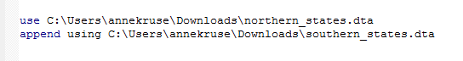
Appending data
You’ll append the data set you have open with another data set on your computer:

Slide 22
Merging data
To merge data, you need to merge BY the correct variables
What are the correct variables?
  Merge by whatever makes the row unique in the data
  This may be one ID variable (e.g., respondent ID), or it may be an ID variable and a year variable, or an ID, year and month variable…
  Note that you may merge data sets with different ‘levels,’ but you can only merge by variables you have in each data set
  Be sure that you know your data before your merge

Slide 23
Merging data
There are a variety of ways of merging, depending on the level of each data set
  One-to-one merges (1:1) – most common, you link one unique row in data set A to one unique row in data set B
    Example – merging a student-level test score data set to a student-level demographics data set
  One-to-many merges (1:m, or m:1) – where you link one unique row in data set A to multiple rows in data set B (or vice versa)
    Examples – merging a teacher-level demographics data set to a student-level data set; merging state-level data to a city-level data set
  Many-to-many merge (m:m) – there is rarely ever a reason for you to do this. In fact, this is exactly what you are usually trying to avoid!

Slide 24
Merging data
Example of a one-to-one merge
  Using our appended data, we can now merge in a test score for each teacher
  First, sort the data by the variables you will merge by
  Then, merge 1:1 {by variables} using the data set
  What happens?

Slide 25

Merging data
This error is telling you that there is at least one instance where two rows have the same teacher ID
Check for duplicates:
  Save the data you are working on
  Open the new data, and tag duplicates records:
  duplicates tag teacherid, gen(dup)
  Code creates a variable that flags the duplicate records
  I then tabulated the dup, browsed the data, and seeing that the records are, in fact, complete duplicates, I decided to drop one, by:
  duplicates drop teacherid, force

Slide 26
Merging data
Merging with the cleaned up data will now work:
. merge 1:1 teacherid using "course_test_scores_nodup.dta"
Result # of obs.
-----------------------------------------
not matched 3
from master 1 (_merge==1)
from using 2 (_merge==2)
matched 48 (_merge==3)
-----------------------------------------
Note that three records didn’t merge. It’s good to examine those to confirm that they shouldn’t have merged. In this case, they were different IDs, so the merge was successful.

Slide 27
Collapsing data
Data can be transposed, reshaped, or collapsed to create aggregated data sets
The collapse command is very simple:
collapse [statistic] [varlist], by(variable_category)
For example:
You may want to save your collapsed data, or use your collapsed dataset to create a table that you can copy into Excel or some other program
The problem is that you often want to continue using the data you collapsed (and saving and opening constantly is a pain)

Slide 28
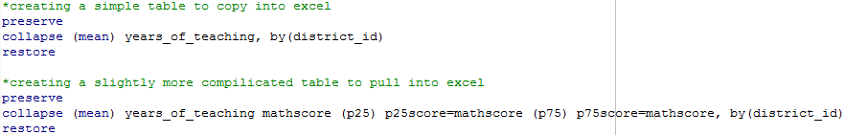
Collapsing data
The solution is to use the ‘preserve’ and ‘restore’ commands
Guess what they do?
(Of course, running this all of this at once in a do file will just erase the collapsed data, so run it one line at a time)

Slide 29
Ask and you shall receive
Remember that in Stata you can always just type “help” + the command and you’ll get a ton of info

Slide 30
Questions?

