Slide 1
Stata Basics
ECONOMETRICS ii – spring 2018

Slide 2
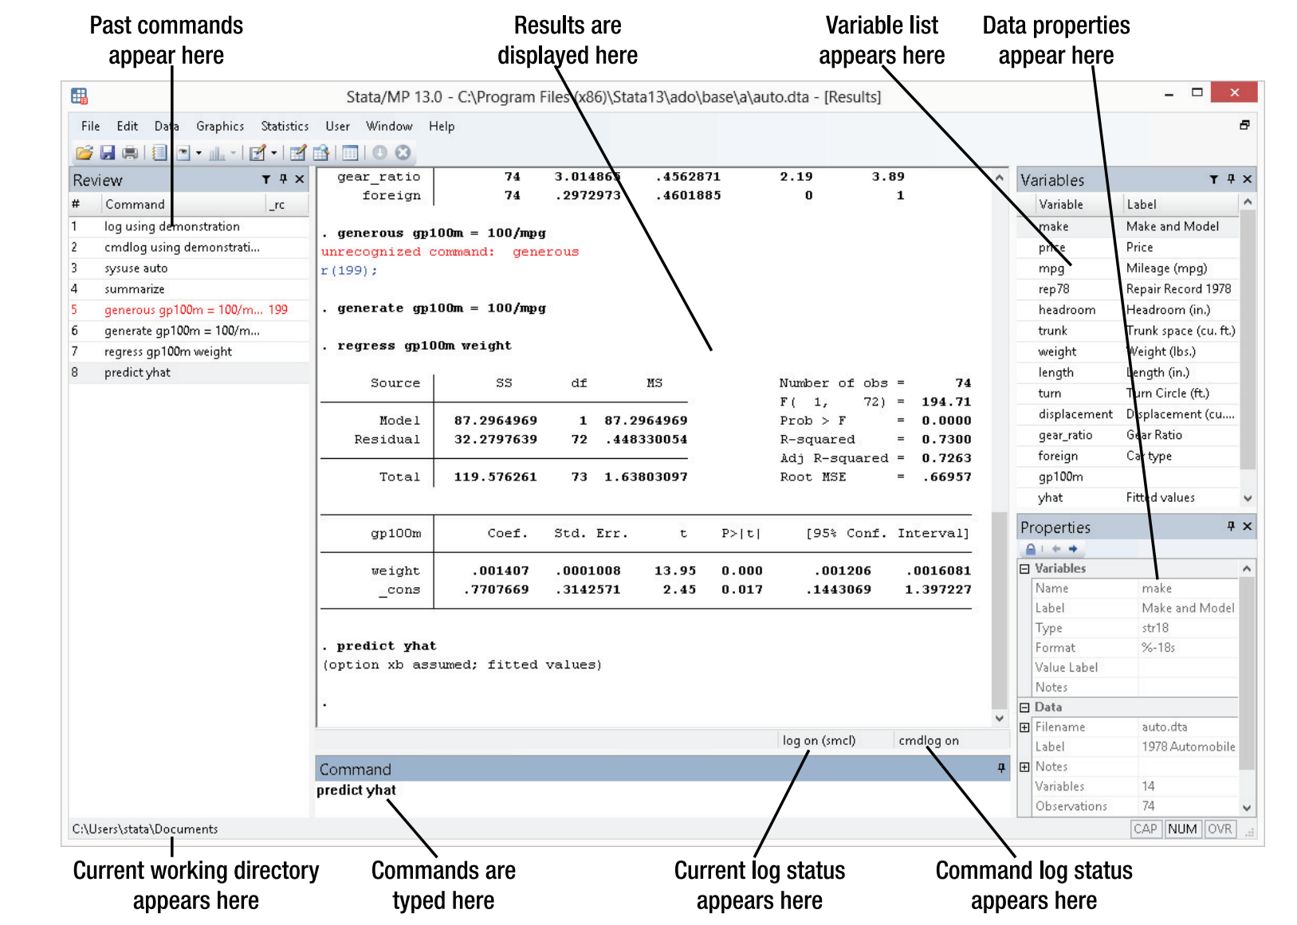
https://www.stata.com/manuals13/gsw2.pdf

Slide 3
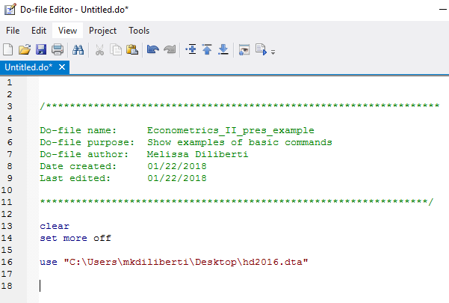
“Do” file
Type your commands here (as opposed to in the “command” box) so that you can preserve the history
Save “do” file so that you can access it later
Common practice to write a “do” file so that you can run the entire file at once
https://www.stata.com/manuals13/u16.pdf

Slide 4
“Do” file: Recommended Practices
ALWAYS use a “do” file
Generally, begin the “do” file by clearing memory using “clear” command
Each “do” file should have a purpose; not everything needs to go in the same “do” file
Add comments to yourself in the “do” file explaining what you are doing and why

Slide 5
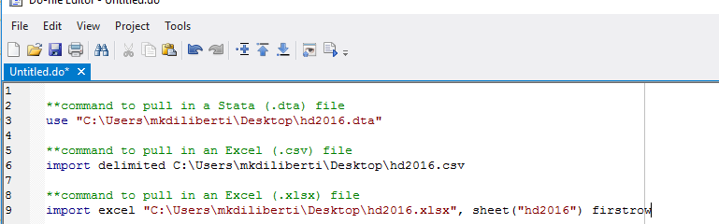
Importing Your Data
You can identify a Stata file by “.dta” extension
It’s fairly easy to pull in Excel (.xlsx or .csv) files; pulling in other file types more complicated. In this case, recommend using StatTransfer
You must tell Stata where the data is stored on your computer
https://www.stata.com/manuals13/u21.pdf

Slide 6
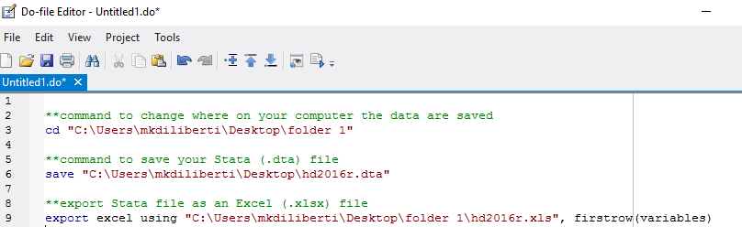
Saving Your Data
You save or export your data in a variety of formats
Recommend saving edited data as a new file; don’t overwrite existing files
Again, you must tell Stata where you want the data to be saved on your computer

Slide 7
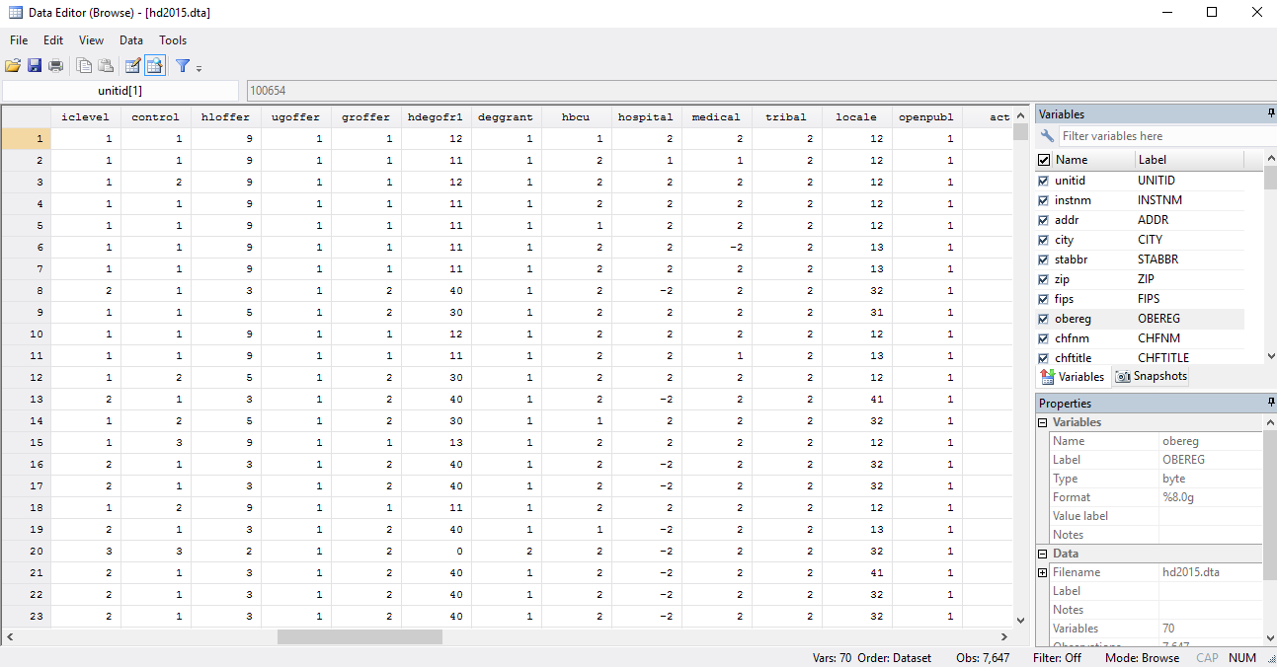
Reviewing Your Data
Use the “browse” (“bro”) command to open up the browser window

Slide 8
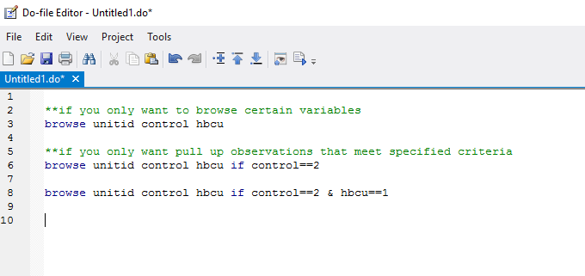
Reviewing Your Data
You can add criteria to the browse command so that you are only reviewing certain observations

Slide 9
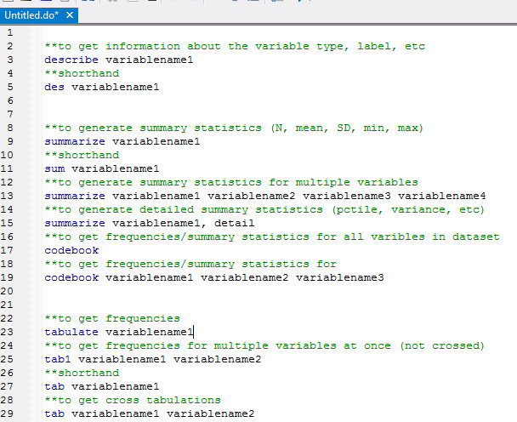

Slide 10
Creating new variables
Use the “generate” command to create new variables **You must specify a value for this new variable
The “egen” command more complicated version
Can only create a new variable if that variable doesn’t already exist. Once a variable exists, you have to replace, not generate
https://www.stata.com/manuals13/gsm11.pdf

Slide 11
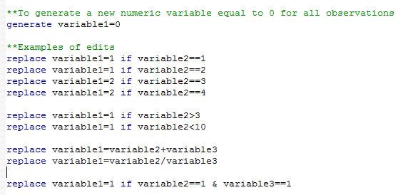
Editing variables
Suggest making one edit at a time. Focus on simple, logical statements
References to learn more about editing variables
https://www.stata.com/manuals13/drecode.pdf
https://stats.idre.ucla.edu/stata/modules/creating-and-recoding-variables/

Slide 12
String variables
String variables are non-numeric variables (also called “text,” “categorical,” or “character” variables)
They show up in red when you look at them in the data editor
The rules for editing string variables are different than editing numeric variables
https://www.stata.com/manuals13/u23.pdf

Slide 13
String vs. numeric variables
Convert from a string to numeric variable (or vice versa)
Editing rules are different for numeric and string variables

Slide 14
Missing values
Treated as large numbers
Stata identifies missing values with “.”
You need to do something with the missing values or you will get very weird results. You have some options, depending on the situation:
(1) Drop the missing values
(2) Top (or bottom) code the missing values** (usually best option)
(3) Recode the missing values as a different value

Slide 15
Appending vs. merging data
There are two basic ways to join datasets together
(1) Appending
(2) Merging
They are not interchangeable
These two commands will join your data together differently
You need to choose the command that is appropriate for your situation
Helpful resource that clearly explains difference between appending and merging https://www.princeton.edu/~otorres/Merge101.pdf
https://www.stata.com/manuals13/dappend.pdf

Slide 16
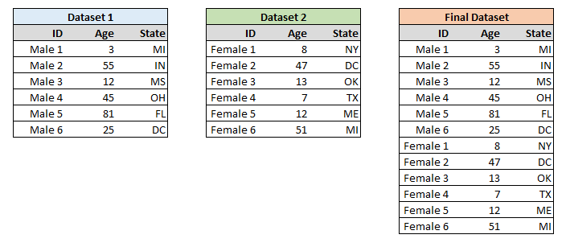
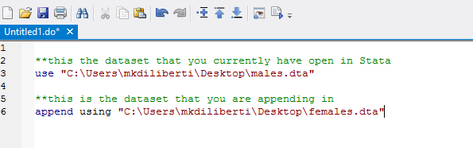
Appending data
Scenario: You have one dataset with data for males and one dataset with data for females. You want to create a dataset that includes both males and females

Slide 17
Appending data: Things to keep in mind
Make sure your datasets have the same variable names before you append them!! It is worth spending time to make sure your variable names are exactly the same between both datasets.
If two datasets have the same variable name, these columns will get stacked on top of each other when you append the two datasets together. Otherwise, you’ll end up with a dataset that makes no sense.

Slide 18
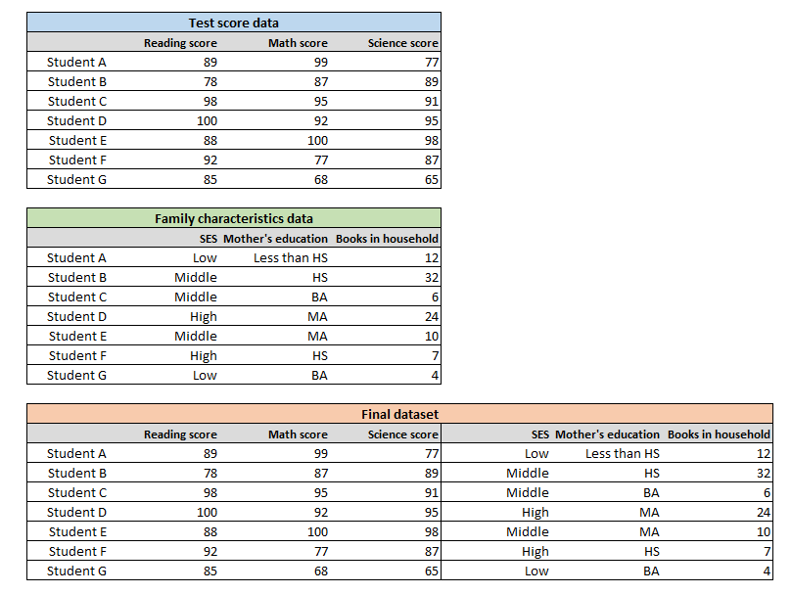
Merging data
Scenario: You have one dataset with data on students’ test scores and one dataset with data on students’ family characteristics. You want to create one dataset with all of this information.

Slide 19
Merging data
One-to-one merge (1:1) – link one unique row in data set A to one unique row in data set B (this is what we did in the previous example)
One-to-many merge (1:m, or m:1) – link one unique row in data set A to multiple rows in data set B (or vice versa)
This is often used when you are linking data sets together at different levels. For example, you want to link state data to county data
Many-to-many merge (m:m)
https://www.stata.com/manuals13/dmerge.pdf

Slide 20
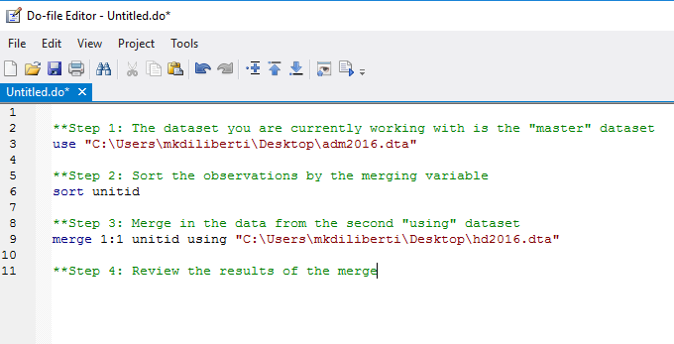
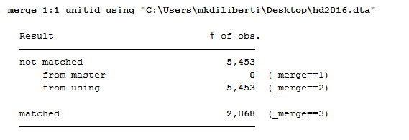
Merging data

Slide 21
Merging data: Things to keep in mind
The key is selecting the correct variable to merge on
Usually this is a unit ID variable, a unique ID, a respondent name, etc. This unique variable needs to be an identifier in both datasets.
Make sure you know which dataset is the “master” and which dataset is the “using”
Review your dataset for duplicates before merging
Always review the output of the merge to make sure it makes sense. Did all of the records merge successfully? If not, why? Is this intentional? Should the records that didn’t merge be dropped? Go through the records that didn’t merge to figure out why they are left over. It’s good practice to add comments about this in your “do” file.

Slide 22
Collapsing data
The “collapse” command can be used to reduce your dataset to summary statistics
Generally used in situations where you need to pull a few statistics that summarize the entire dataset (perhaps to answer a quick query) but then return to the full dataset
Use the ‘preserve’ and ‘restore’ commands so that you can return to the full dataset. **Must run code one line at a time.
Summarized data will go away when you return to full dataset.
https://www.stata.com/manuals13/dcollapse.pdf

Slide 23
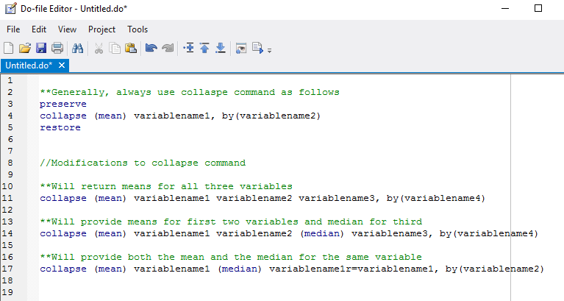

Slide 24
Syntax for different statistics
https://www.stata.com/manuals13/rtabstat.pdf

Slide 25
Programming: Recommended Practices
Add LOTS of comments in your “do” files
Use * to add a comment to one line
Can start and end a block of text with /* and */
Consistency in variable naming will save you time
For example, if you generate 3 year variables call them “year_birth” “year_grad” “year_migrate” not “birthyear” “year_grad” and “yearofmigration”
Focus on doing one thing in each step; group similar steps together in your “do” file
Any other recommendations from personal experience?

Slide 26
Suggestions for future topics?
1/24 – Stata overview
1/31 – xi regression command vs. creating all FE variables
2/7 –
2/14 –
2/21 –
2/28 –
3/7 – export tables/regressions/charts into Excel
3/28 –
4/4 –
4/11 –
4/18 –

Slide 27
Reference Tools for Learning Stata
The way to learn Stata is by trial and error
Type “help” + command of interest into STATA
Me! (mkdiliberti@gwu.edu)
GW Library Event (https://library.gwu.edu/news-events/events/introduction-stata)
Links at the bottom of these slides
Online resources
https://stats.idre.ucla.edu/stata/modules/
https://www.stata.com/support/faqs/data-management/true-and-false/
https://www.youtube.com/user/statacorp/videos
https://www.stata.com/links/resources-for-learning-stata/
Thank you to Anne Kruse; I adapted this PowerPoint from one she created last year!

