Slide 1
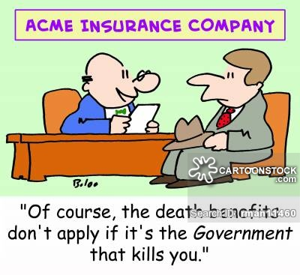
UnitedHealth Lowers Forecast, Blaming Affordable Care Act
The new York Times

Slide 2
ARTICLE HIGHLIGHTS
UnitedHealth Group:
One of the nation’s largest health insurance companies
Significantly lowered its profit estimates: Blames ObamaCare
Expects losses of more than $600 million on selling individual policies
Weighing options to offer individual coverage through the online exchanges
The ACA: made it easier for individuals to buy coverage if they are not covered by an employer.

Slide 3
MAIN FOCUS
Premiums have risen significantly in some parts of the country.
Difficulty drawing large numbers of new and healthy customers
customers are enrolling for only short periods of time and consuming significant amounts of medical care.
New insurers offering coverage: have stopped selling policies for next year, leaving people with fewer options.
About 10 million people are expected to enroll for 2016.
United Health have enrolled about 550,000 customers to date, less than its major rivals.

Slide 4

SOUNDS FARMILIAR YET?
High costs of medical care for existing customers
Industry data: signals higher risks and claims experience deteriorating
Insurers would leave the public exchanges if they cannot break even next two years

Slide 5

Adverse Selection
The problem of adverse selection is that individuals know more about their risk level than does the insurer might cause those most likely to have adverse outcomes to select insurance, leading insurance to lose money if they offer insurance.

Slide 6

High Risk Groups Are Buying More Insurance
High-expense group find the insurance under the exchanges to be a good deal
Low risk group finds it a bad deal; will leave market if able

Slide 7

Government Intervention Inadequate
One of the reasons so many of the start-ups have faltered.
Government currently paying less than 13 cents of every dollar they owe.
Notes:
Critics have argued that some of the original provisions to protect insurers from losses have not been sufficient
Increasing insurers administrative costs

Slide 8
UnitedHealth Competitors Doing Better
Anthem: Operates for-profit Blue Cross plans has indicated it is not losing money in the market.
Using combination of higher prices and better management of medical expenses
Notes:
Indication of separating equilibrium: Offering different products at different prices ( full information of consumers and charges higher for better coverages

Slide 9


