Slide 1
Using Credit Scores to Fix Auto Insurance Rates
Cassandra Kubes
PPPA 6085, Evening Session
December 1, 2015
Notes:
Article: http://kfor.com/2015/11/25/its-just-unfair-consumers-vent-over-credit-scores-leading-to-higher-insurance-prices/
Background: http://www.iii.org/issue-update/credit-scoring

Slide 2
Summary:
Article: “Consumers vent over credit scores leading to higher insurance prices”
Since the 1990’s, auto insurance companies have been using credit scores to determine insurance rates
Poor credit > higher premiums
Unfairly targeting low-income customers
Legal practice in all states, except CA, HI, MA
Oklahoma state senator proposing bill to make scoring practice illegal
Notes:
Section 604 of the Fair Credit Reporting Act says that the credit reporting agencies, Equifax (EFX), Experian (EXPN) and TransUnion, may furnish reports to any company that intends to use that information for the purpose of underwriting insurance.
Approximately 95% of auto insurers and 85% of homeowners insurers use credit-based insurance scores in states where it is a legally allowed underwriting or risk classification factor.
Insurance related inquiries are not counted in your credit scores so they don’t lower your credit score. Companies’ scoring system varies, and they do not have to disclose to customers (*When determining your car insurance credit score, sex, marital status, age, ethnicity, address and income are not considered.)
“..they have determined that if you have a higher credit score, you are more financially stable," McGuire said. "I believe they want more financially stable insurers. Under the belief, they won’t file as many claims and they will pay their premiums on time.”
Research shows that credit scores can accurately predict accident potential. Statistical analysis shows that those with higher credit scores tend to get into fewer accidents and cost insurance companies less than their lower-scoring counterparts.

Slide 3
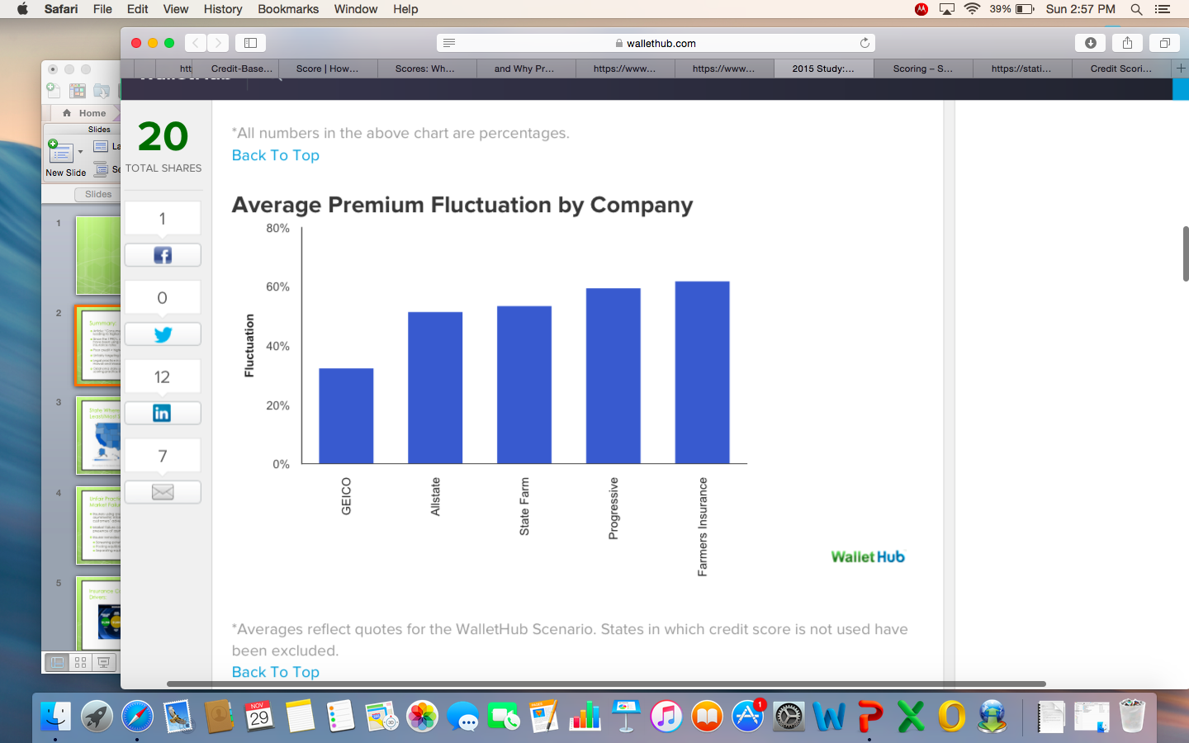
Average Premium Fluctuation by Company
Notes:
Wallet Hub 2015 study compared person with excellent credit vs. person with no credit (holding all else equal)
Farmers Insurance appears to rely on credit data the most, with the WalletHub Scenario revealing a 62% fluctuation in premiums between a consumer with excellent credit and a consumer with no credit. GEICO, on the other hand, appears to rely on credit data the least, displaying a 32% premium fluctuation.
Additional:
There is a 49% differential in the cost of car insurance premiums for a person with an excellent credit score and a person with no credit history, in the average state.
Credit data has the smallest impact on insurance premiums in Connecticut (15% fluctuation) and the biggest impact in the Michigan (115% fluctuation).
Source: https://wallethub.com/edu/car-insurance-by-credit-score-report/4343/

Slide 4
Unfair Practice or Combating Market Failure?
Insurers using credit scores to limit amount of asymmetric information
Market failure can sometimes occur with presence of asymmetric information that leads to adverse selection
Insurer remedies:
  Screening potential customers
  Denying coverage
  Pooling equilibrium
  Separating equilibrium
Notes:
Asymmetric information: arises when customers know more about underlying risk than insurers do
Adverse selection: customers underlying knowledge of their personal risk causes those most likely to have an adverse outcome to choose insurance, leading insurers to lose money
Unfavorable credit factors might include:
Payment history: delinquencies, past-due payments
High use of available credit
Length of credit history
Types of credit (credit cards, loans)
Pooling equilibrium is an efficient outcome is the risk adverse are willing to pay the rick premium (associated with the averaging of premiums: the mount above the actuarially fair price)
Separating equilibrium is only an efficient outcome when the customers in each rate bracket et full (not partial) coverage

Slide 5
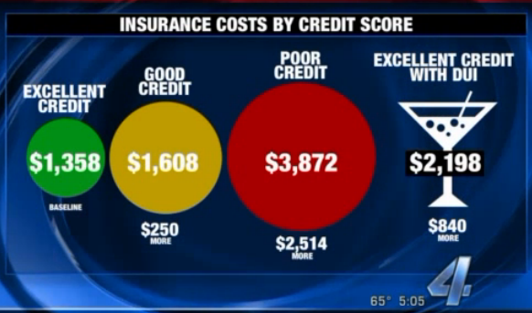
Insurance Costs for Oklahoma Drivers:
Notes:
A study highlighted in the article illustrates an example from Oklahoma, where drivers with clean records and credit problems are compared to drivers with good credit and DWI's.
It found drivers with bad credit and clean records paid more than those with excellent credit but had driving under the influence convictions.
Source: http://kfor.com/2015/11/25/its-just-unfair-consumers-vent-over-credit-scores-leading-to-higher-insurance-prices/

Slide 6
Insurance Pricing by Customer Group:
Information Known to Insurers | Pricing Approach | Premium: Excellent Credit (100 ppl) | Premium: Good Credit (100 ppl) | Premium: Poor Credit (100 ppl) | Total Premiums Paid | Total Benefits Paid Out | Net Profits to Insurer
Credit Score | Separate | $1,358 | $1,608 | $3,872 | (100*1358)+ (100*1608)+ (100*3872) = $683,800 | $683,800 | 0
Asymmetric(Credit score unknown) | Separate | $1,358 | $1,608 | $3,872 | (300*1358)+ (0*1608)+ (0*3872) = $410,400 | $683,800 | -$273,400
Asymmetric (Credit score unknown) | Pooling Average | $2,279 | $2,279 | $2,279 | (100*2279) = $227,900 | $683,800 | -$455,900
Notes:
Table calculating the effects of asymmetric information using what we learned in class.

Slide 7
Will Banning Use of Credit History Help?
Depends on how much each insurer relies on the credit history data to set rates
Look to CA, HI, and MA for example
Variety of other screening practices exist
New screening capabilities/technologies being introduced (i.e. usage-based insurance)
Notes:
Real question is - help whom? The customers or the insurers?
Farmers Insurance appears to rely on credit data the most, with the WalletHub Scenario revealing a 62% fluctuation in premiums between a consumer with excellent credit and a consumer with no credit. GEICO, on the other hand, appears to rely on credit data the least, displaying a 32% premium fluctuation.
Out of the five major insurance providers that WalletHub examined, Geico use credit data in the fewest states (30), while Allstate uses credit data in all but three states.
The fact that CA, HI, and MA do not use credit scores indicates that auto insurance companies can still be profitable without using it to screen customers
Other screening practices include:
Age or driving experience
How your vehicle is used
Driving and claims history
Claims history
Make and model of your vehicle(s)
Geographic location
New technologies and screening capabilities can take the place of using credit scores; “Pay-as-you-drive” optional policy currently exists in CA

