Slide 1

So How Much Should I Tip?
Assessing The Impact of Initiative-82 on restaurant workers in DC

Slide 2
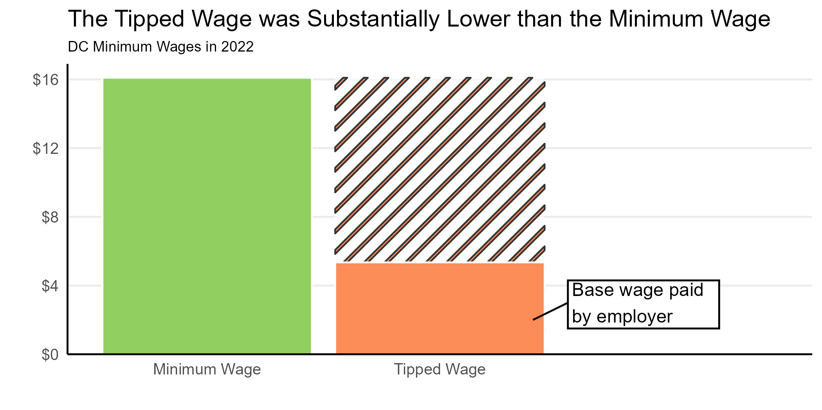
What is the “Tipped Wage”?
Employees must be paid at least a certain hourly wage by their employer
Workers who receive most of their income from tips/gratuities receive a significantly lower hourly wage
Total Income from tips + base wage MUST equal or exceed minimum wage

Slide 3
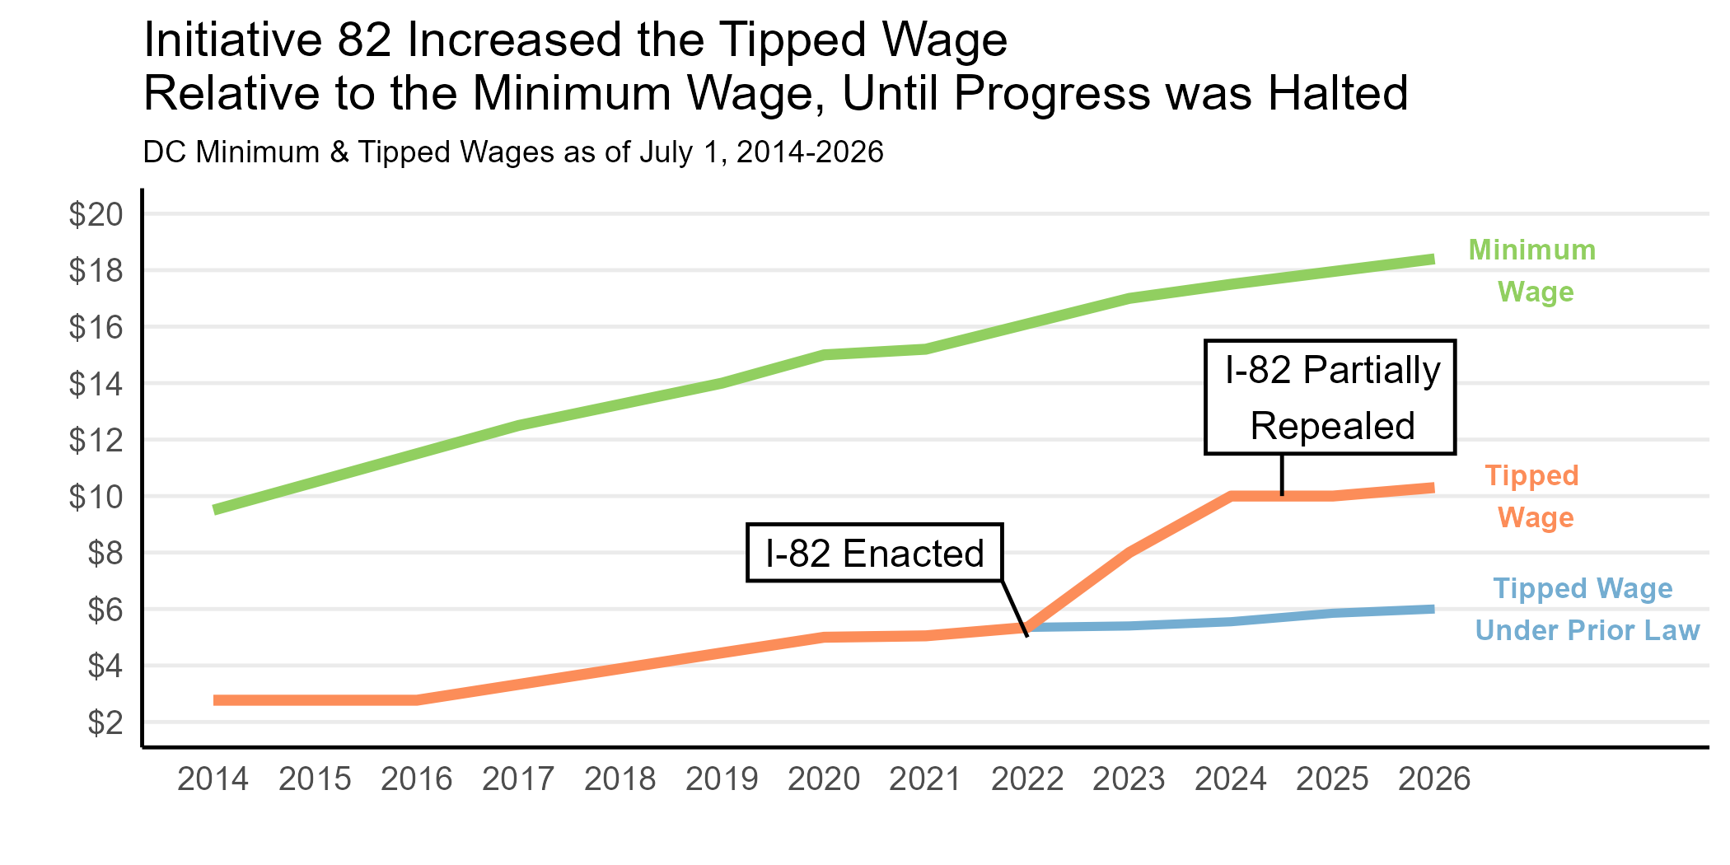
What is Initiative-82?
In 2022, DC voters approved a ballot initiative to eliminate the tipped wage
In 2024, responding to concerns from the restaurant industry, the DC Council partially repealed I-82
The new law will gradually raise the tipped wage to 75% of the minimum wage by 2034

Slide 4

What impact did I-82 really have on tipped workers in DC?

Slide 5
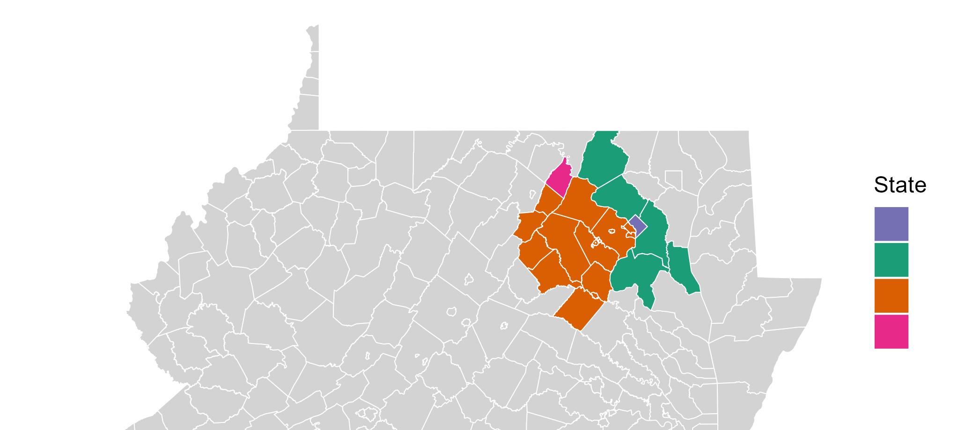
Data and Sample: DC Metro Area

Slide 6
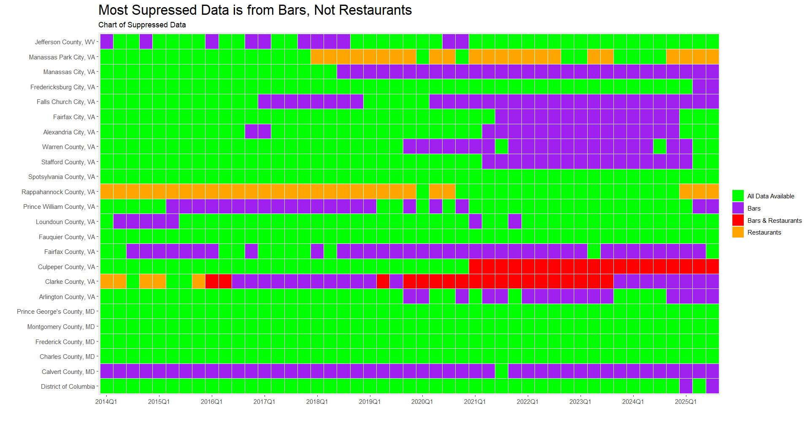
Quarterly Census of Employment and Wages

Slide 7

What Does the Data Show?

Slide 8
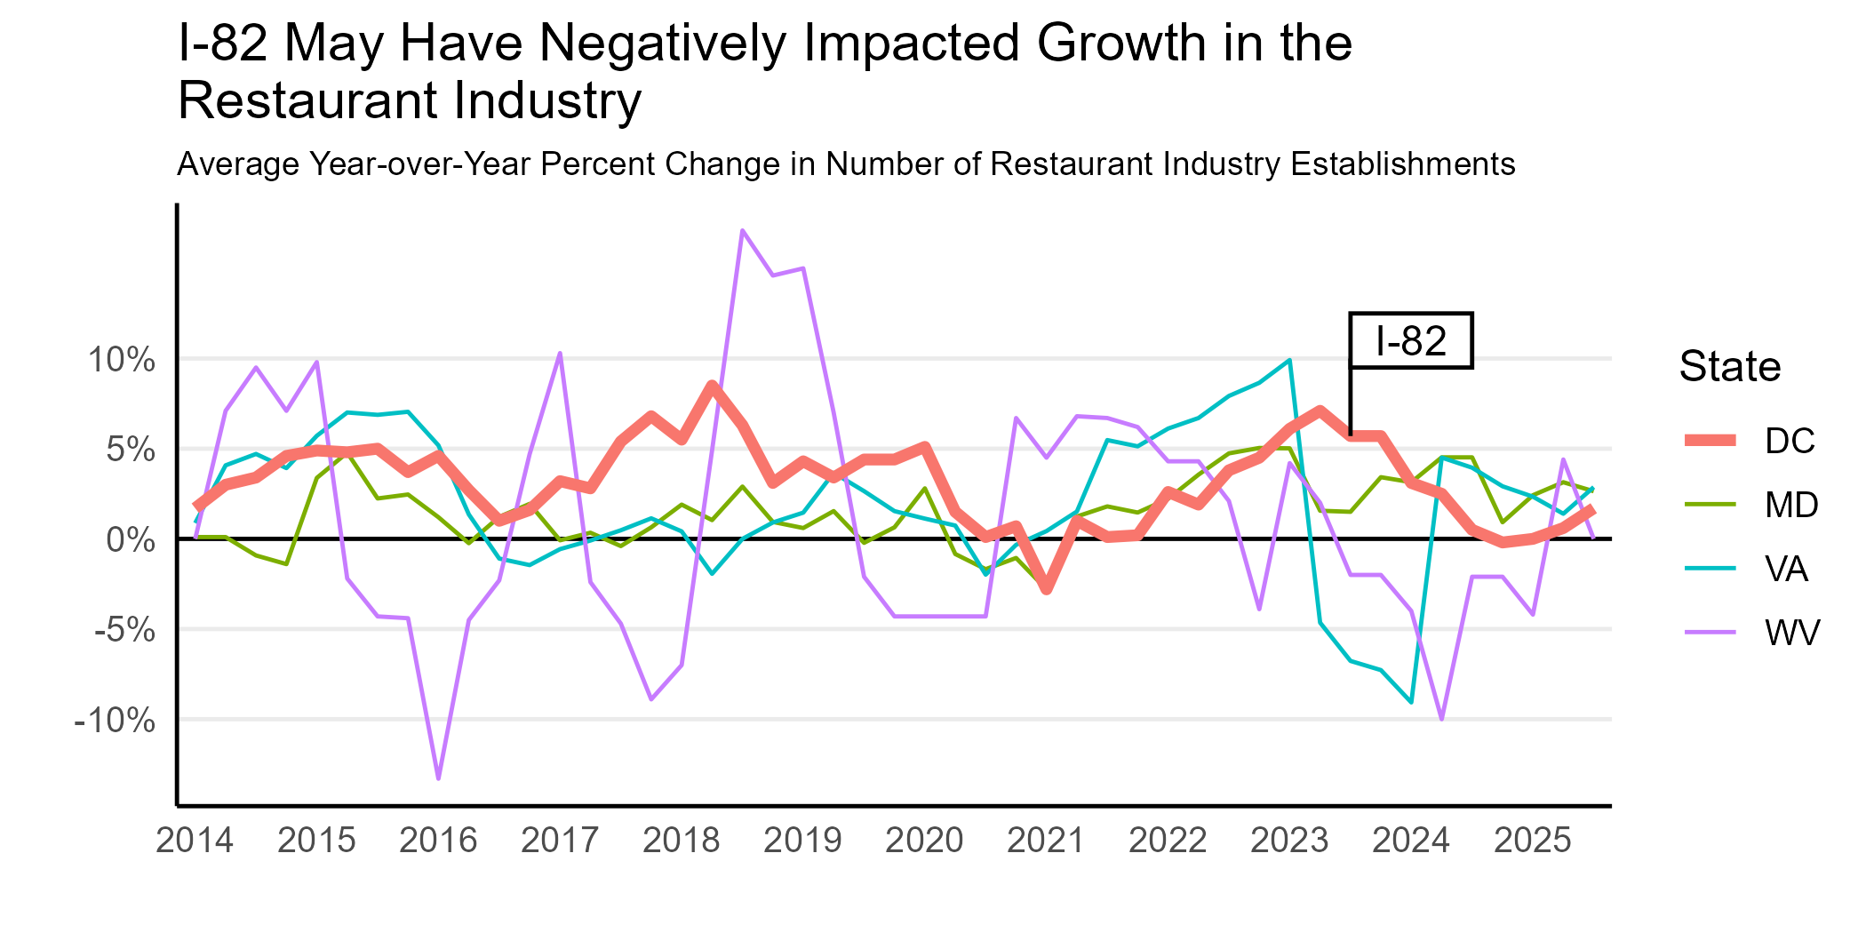

Slide 9
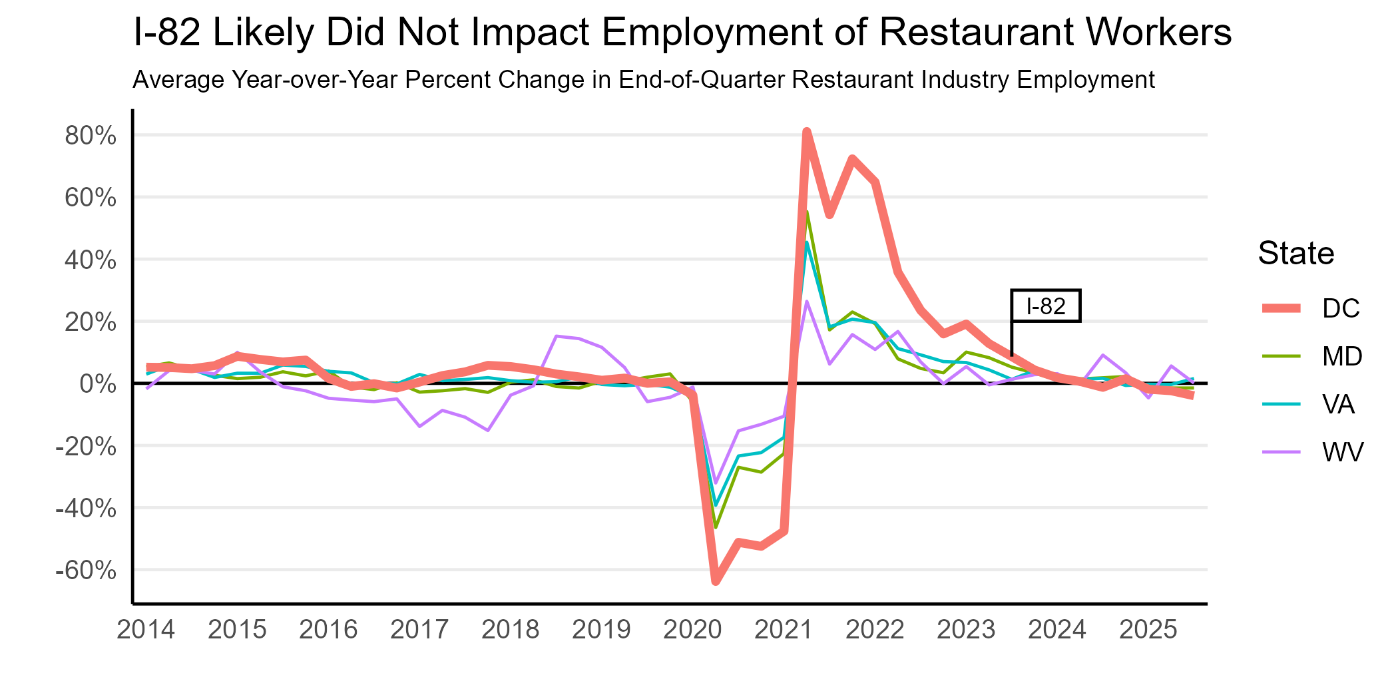

Slide 10
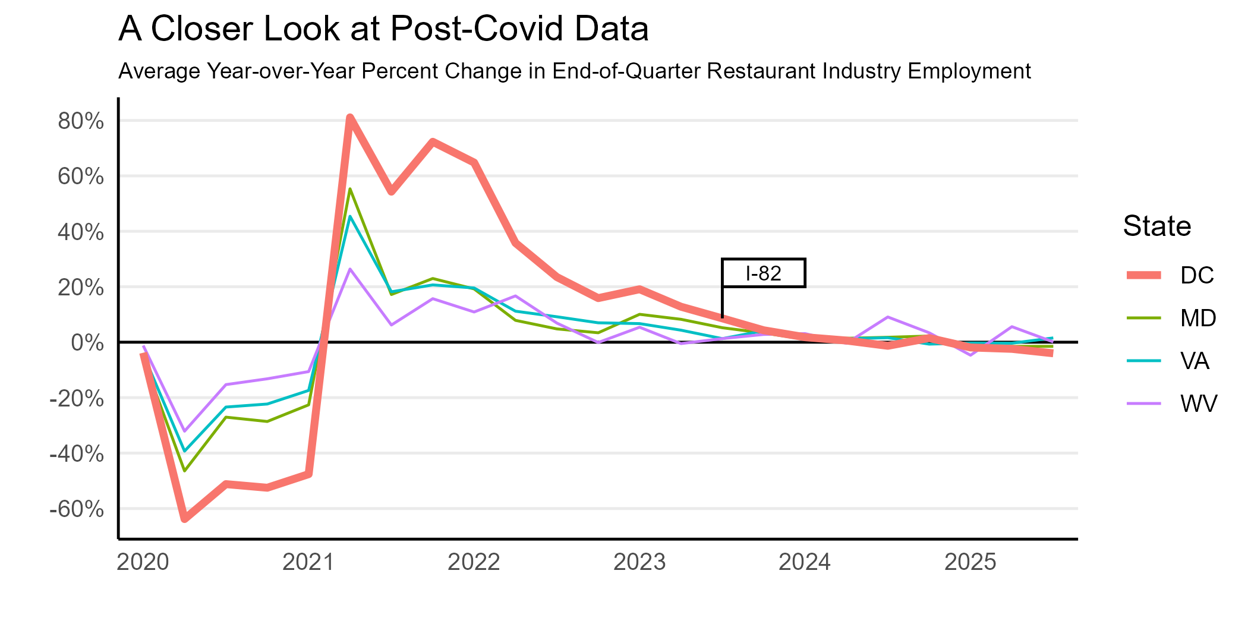

Slide 11
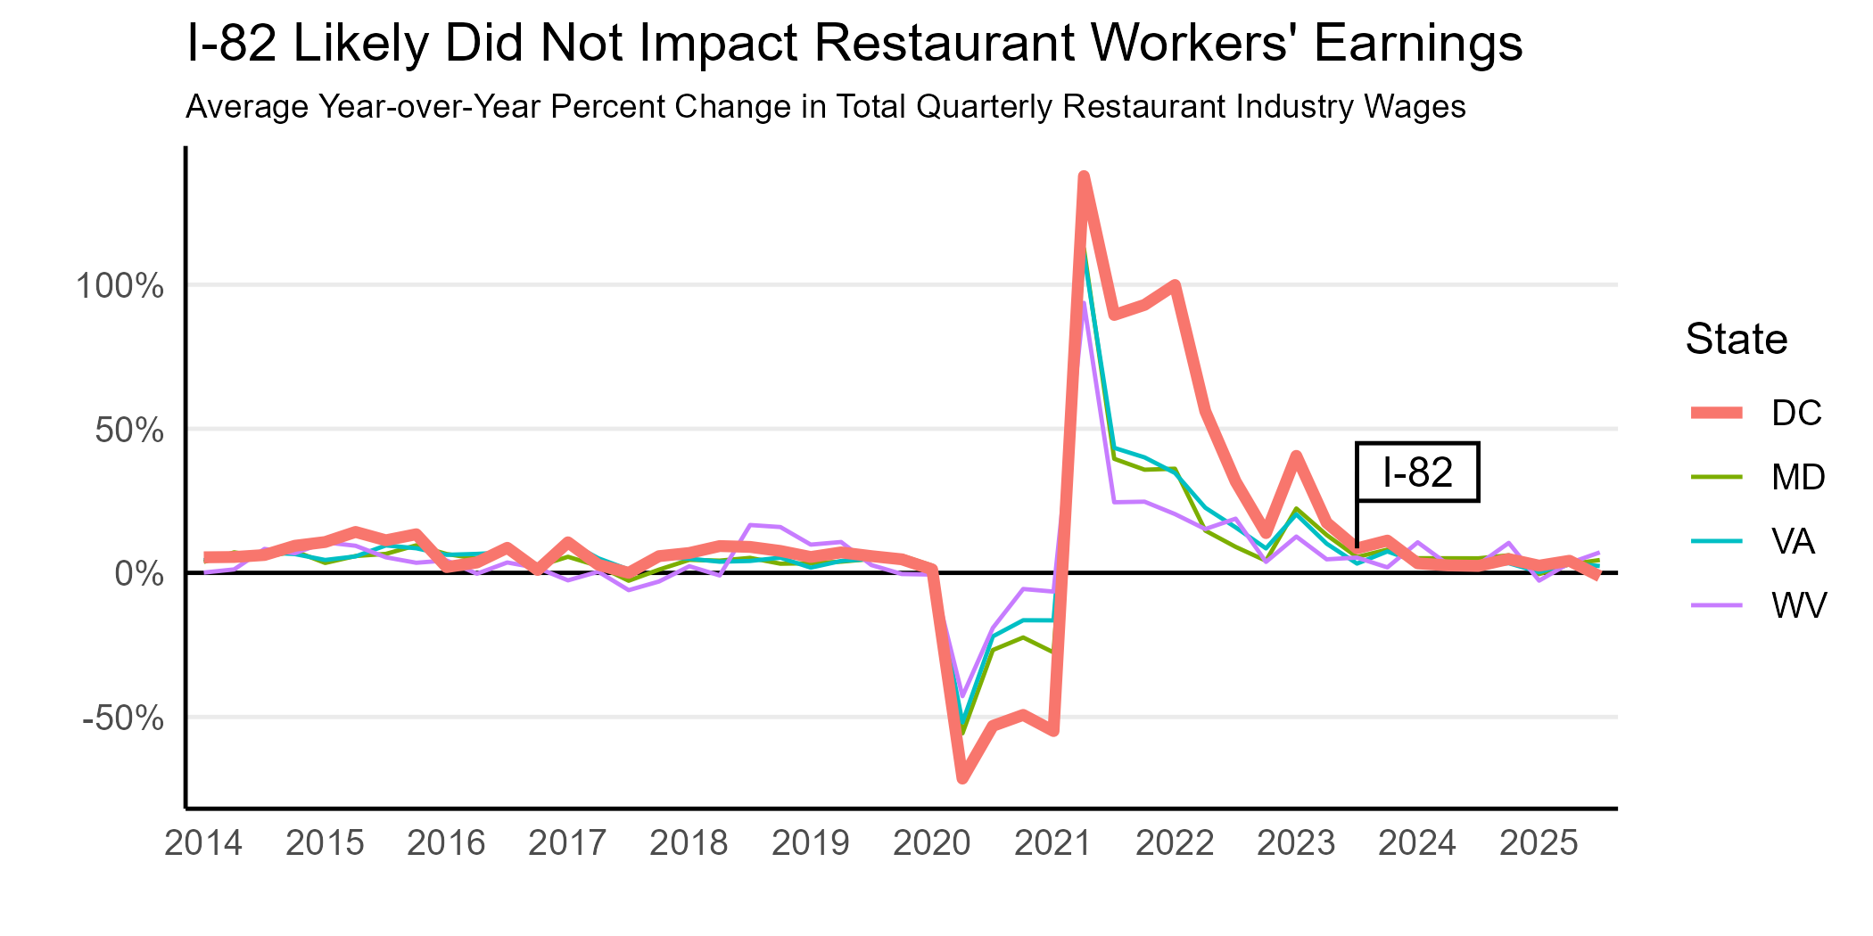

Slide 12
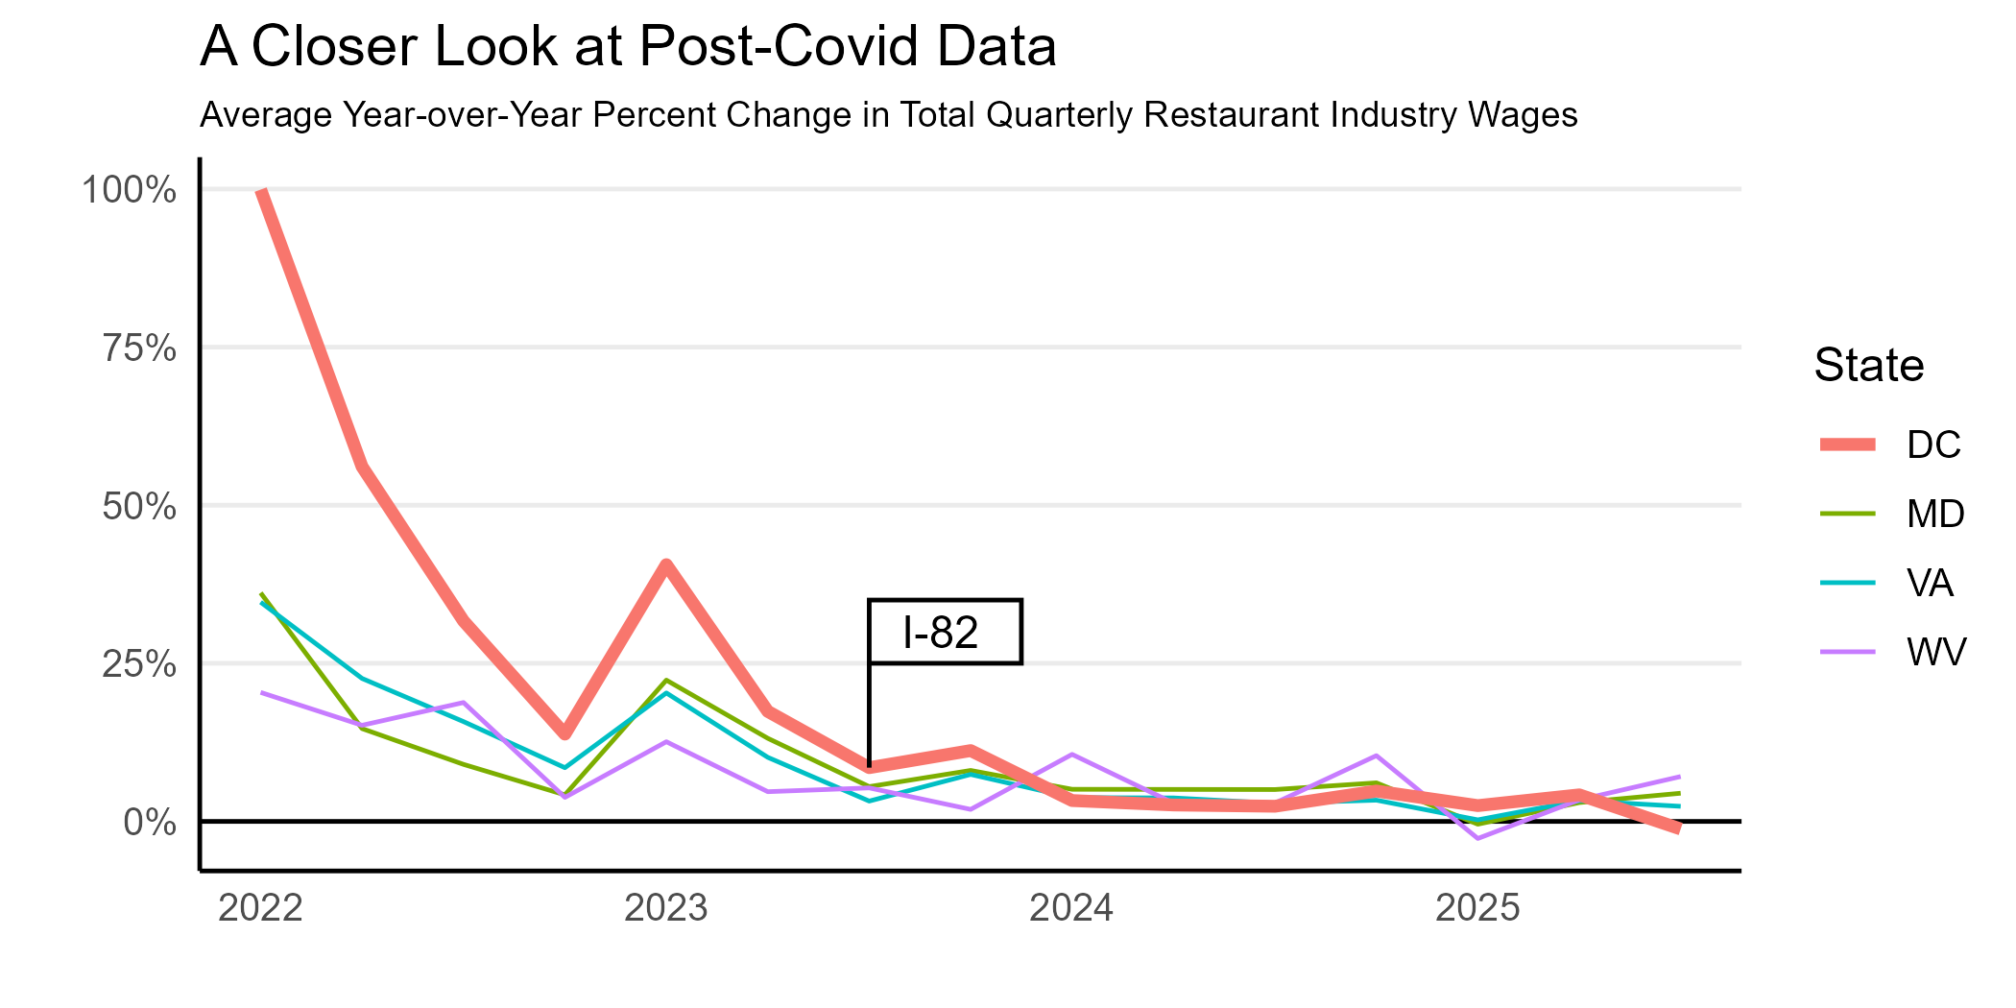

Slide 13
Conclusions and Remaining Questions
I-82 may have reduced growth in DC’s restaurant industry, but does not appear to have caused significant harm to restaurant workers
Future research may investigate how rising labor costs compare with other rising input costs for Restaurants

Slide 14
Thank You!
Questions?

