Slide 1
Major Disaster Declarations
George Doehne – PPPA 6014

Slide 2
Standard procedure for major disasters
The 1988 Stafford Act, passed by Congress, outlines the process by which the federal government declares major disasters and responds to them.
A major disaster is “any natural catastrophe (including any hurricane, tornado, storm, high water, wind-driven water, tidal wave, tsunami, earthquake, volcanic eruption, landslide, mudslide, snowstorm, or drought), or, regardless of cause, any fire, flood, or explosion … which in the determination of the President causes damage of sufficient severity and magnitude …”
A disaster occurs
State governor requests disaster declaration
FEMA analyzes damage and makes a recommendation
POTUS decides

Slide 3
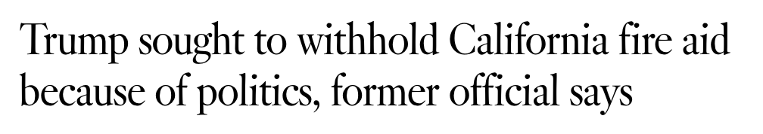

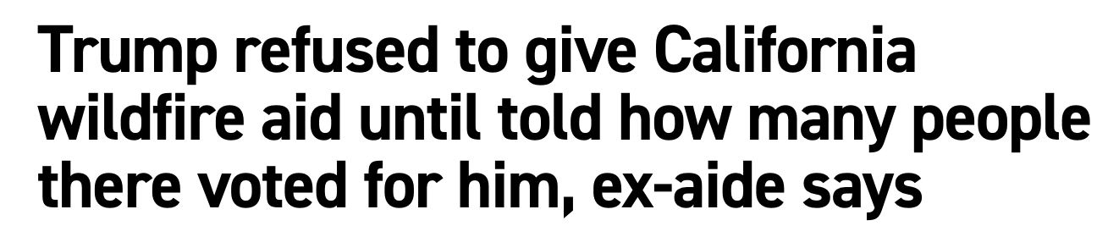
Why am I interested in this?
Executive Order 14180 from January 24, 2025
  “Federal responses to … recent disasters demonstrate the need to drastically improve [FEMA’s] efficacy, priorities, and competence”
  “There are serious concerns of political bias in FEMA.”
  “Americans deserve an immediate, effective, and impartial response to and recovery from disasters.”
Accusations of bias in both directions
  Can we figure out what’s actually going on?
Notes:
“Just pulled some quotes from it because if you remember them, it makes for a little dramatic irony in a few slides

Slide 4
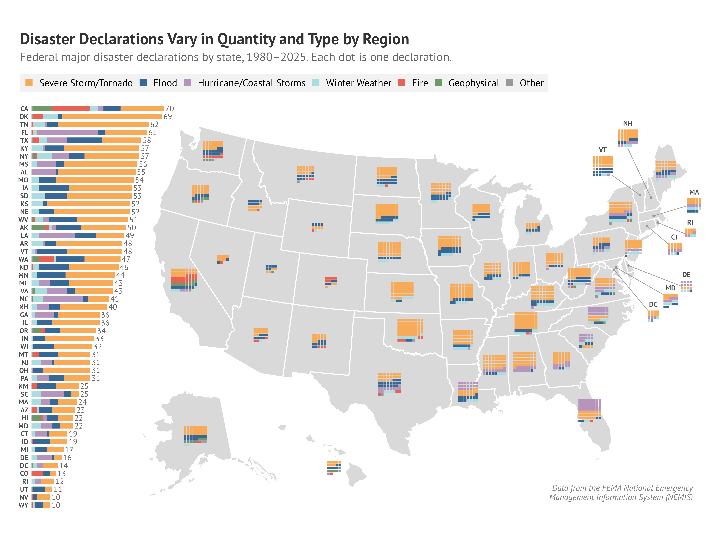
What is the “normal” distribution of disasters?

Slide 5
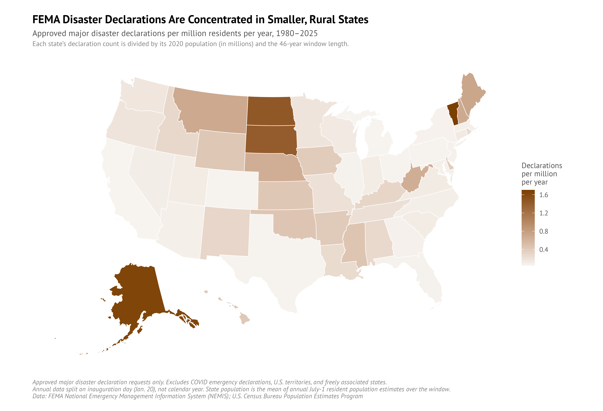
What is the “normal” distribution of disasters?

Slide 6
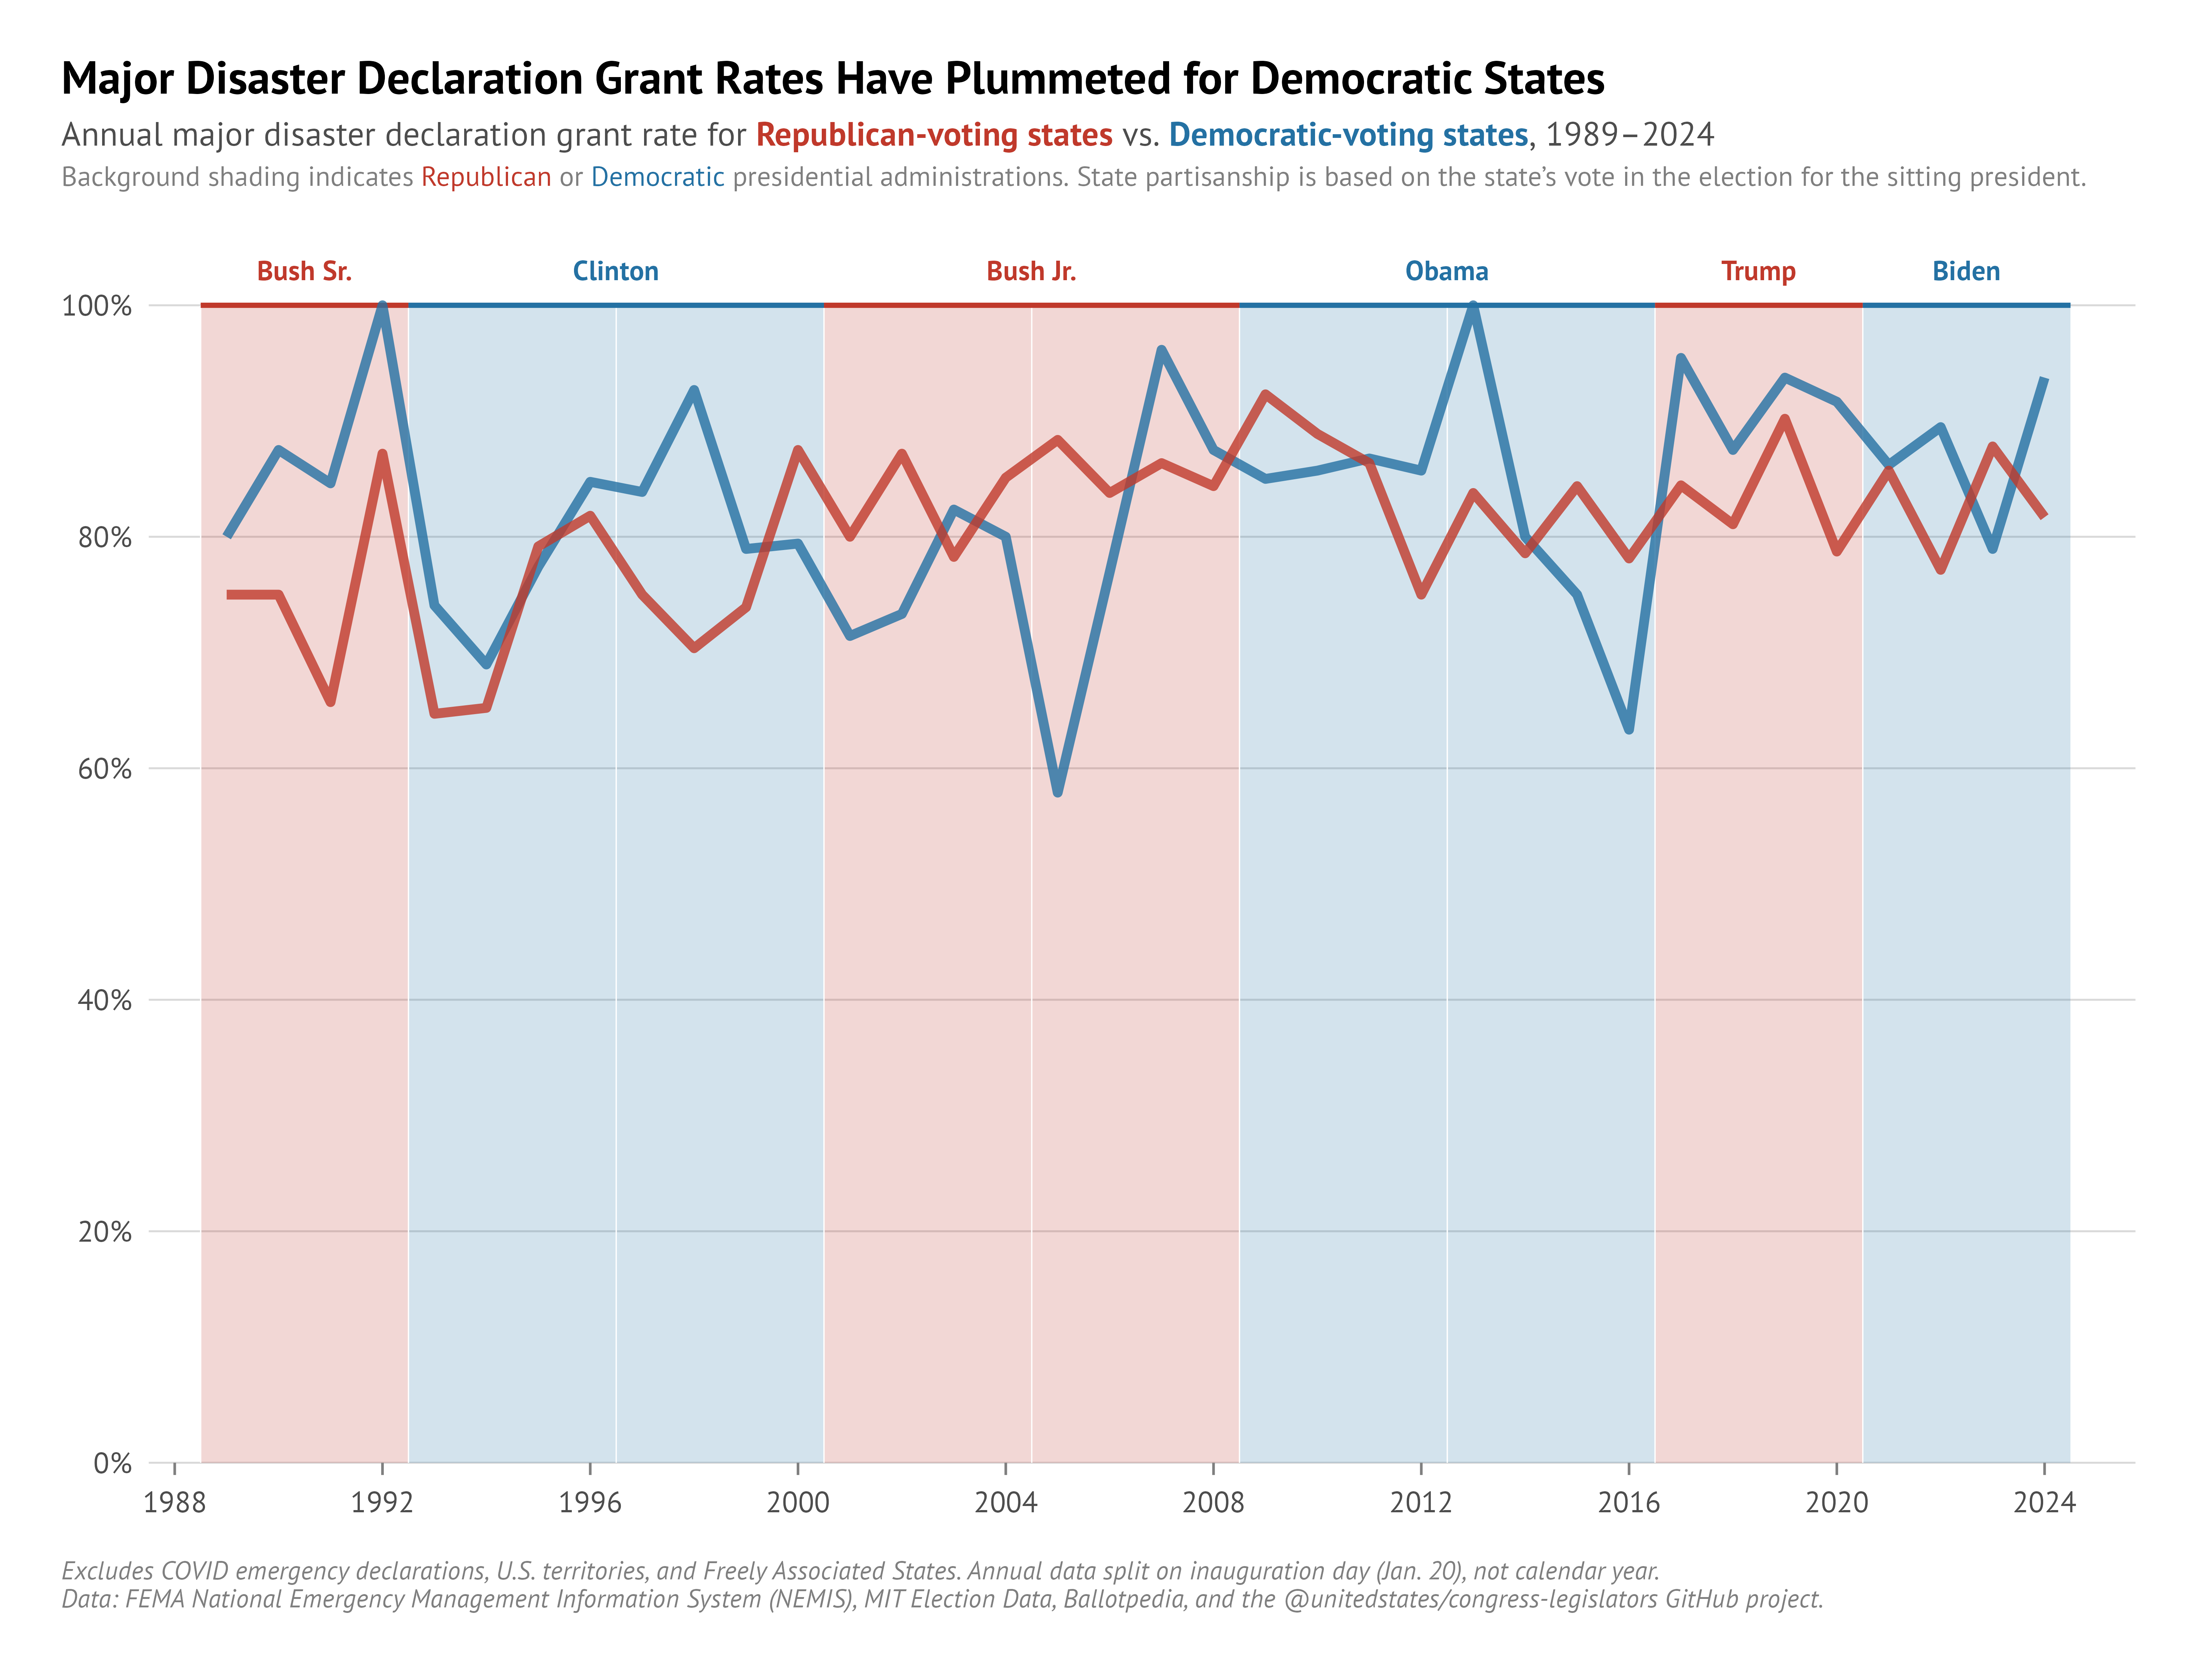
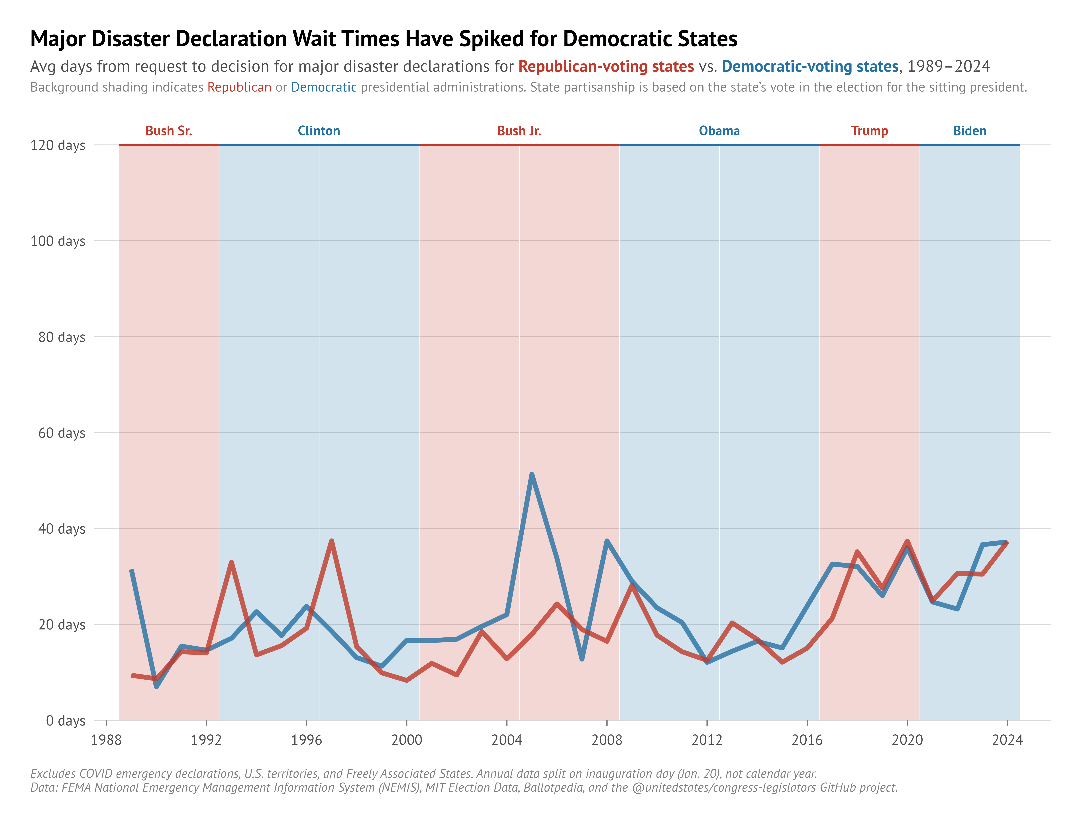
Process outcomes have been stable over time
GRANT RATES REMAIN STABLE OVER TIME
TIME TO DECISION IS STABLE TO SLOWLY RISING

Slide 7
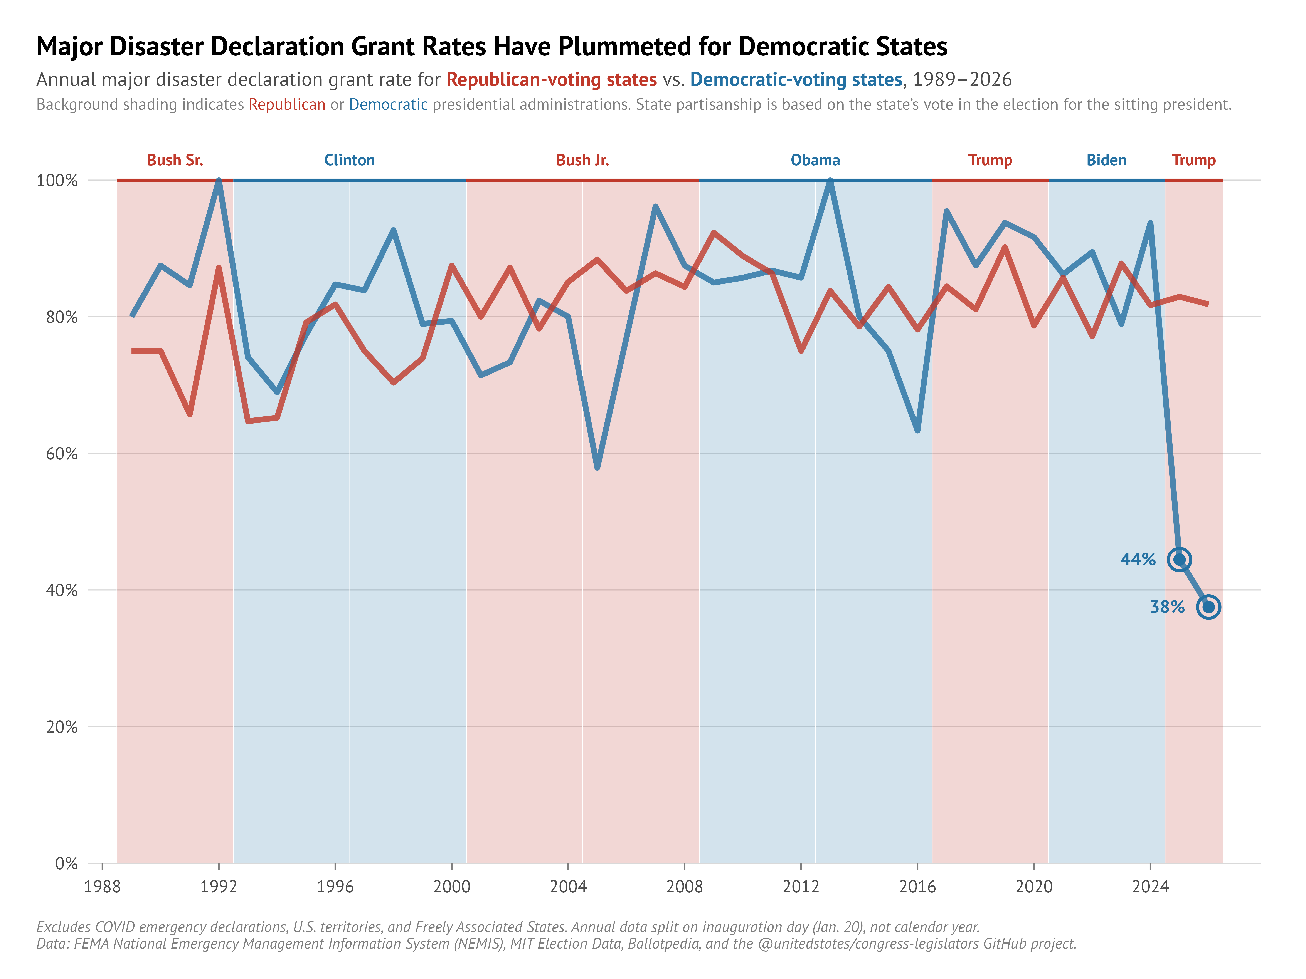
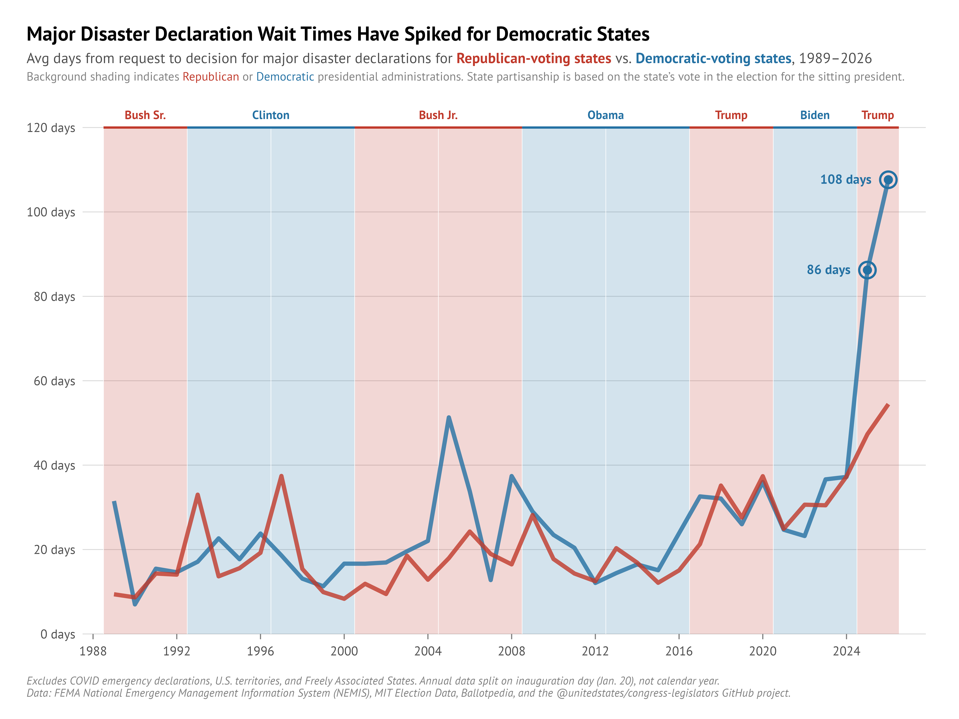
… until now!
BLUE STATES SEEING
ALL-TIME HIGHS
GRANT RATES REMAIN STABLE OVER TIME
TIME TO DECISION IS STABLE TO SLOWLY RISING
BLUE STATES SEEING
ALL-TIME LOWS

Slide 8
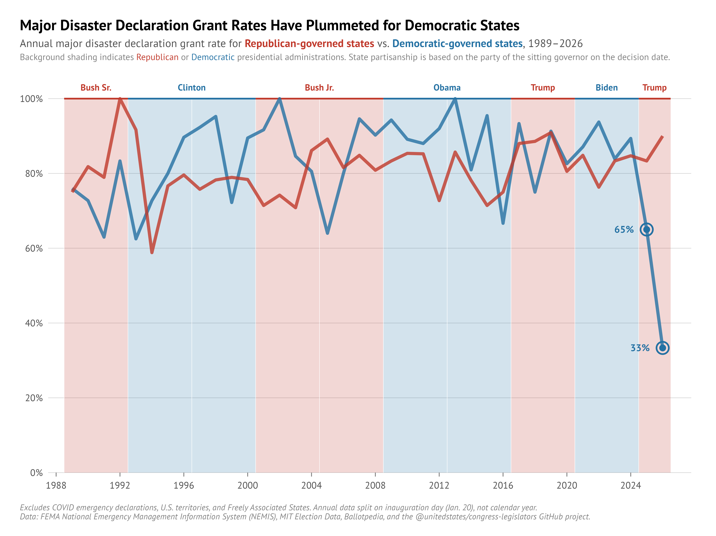
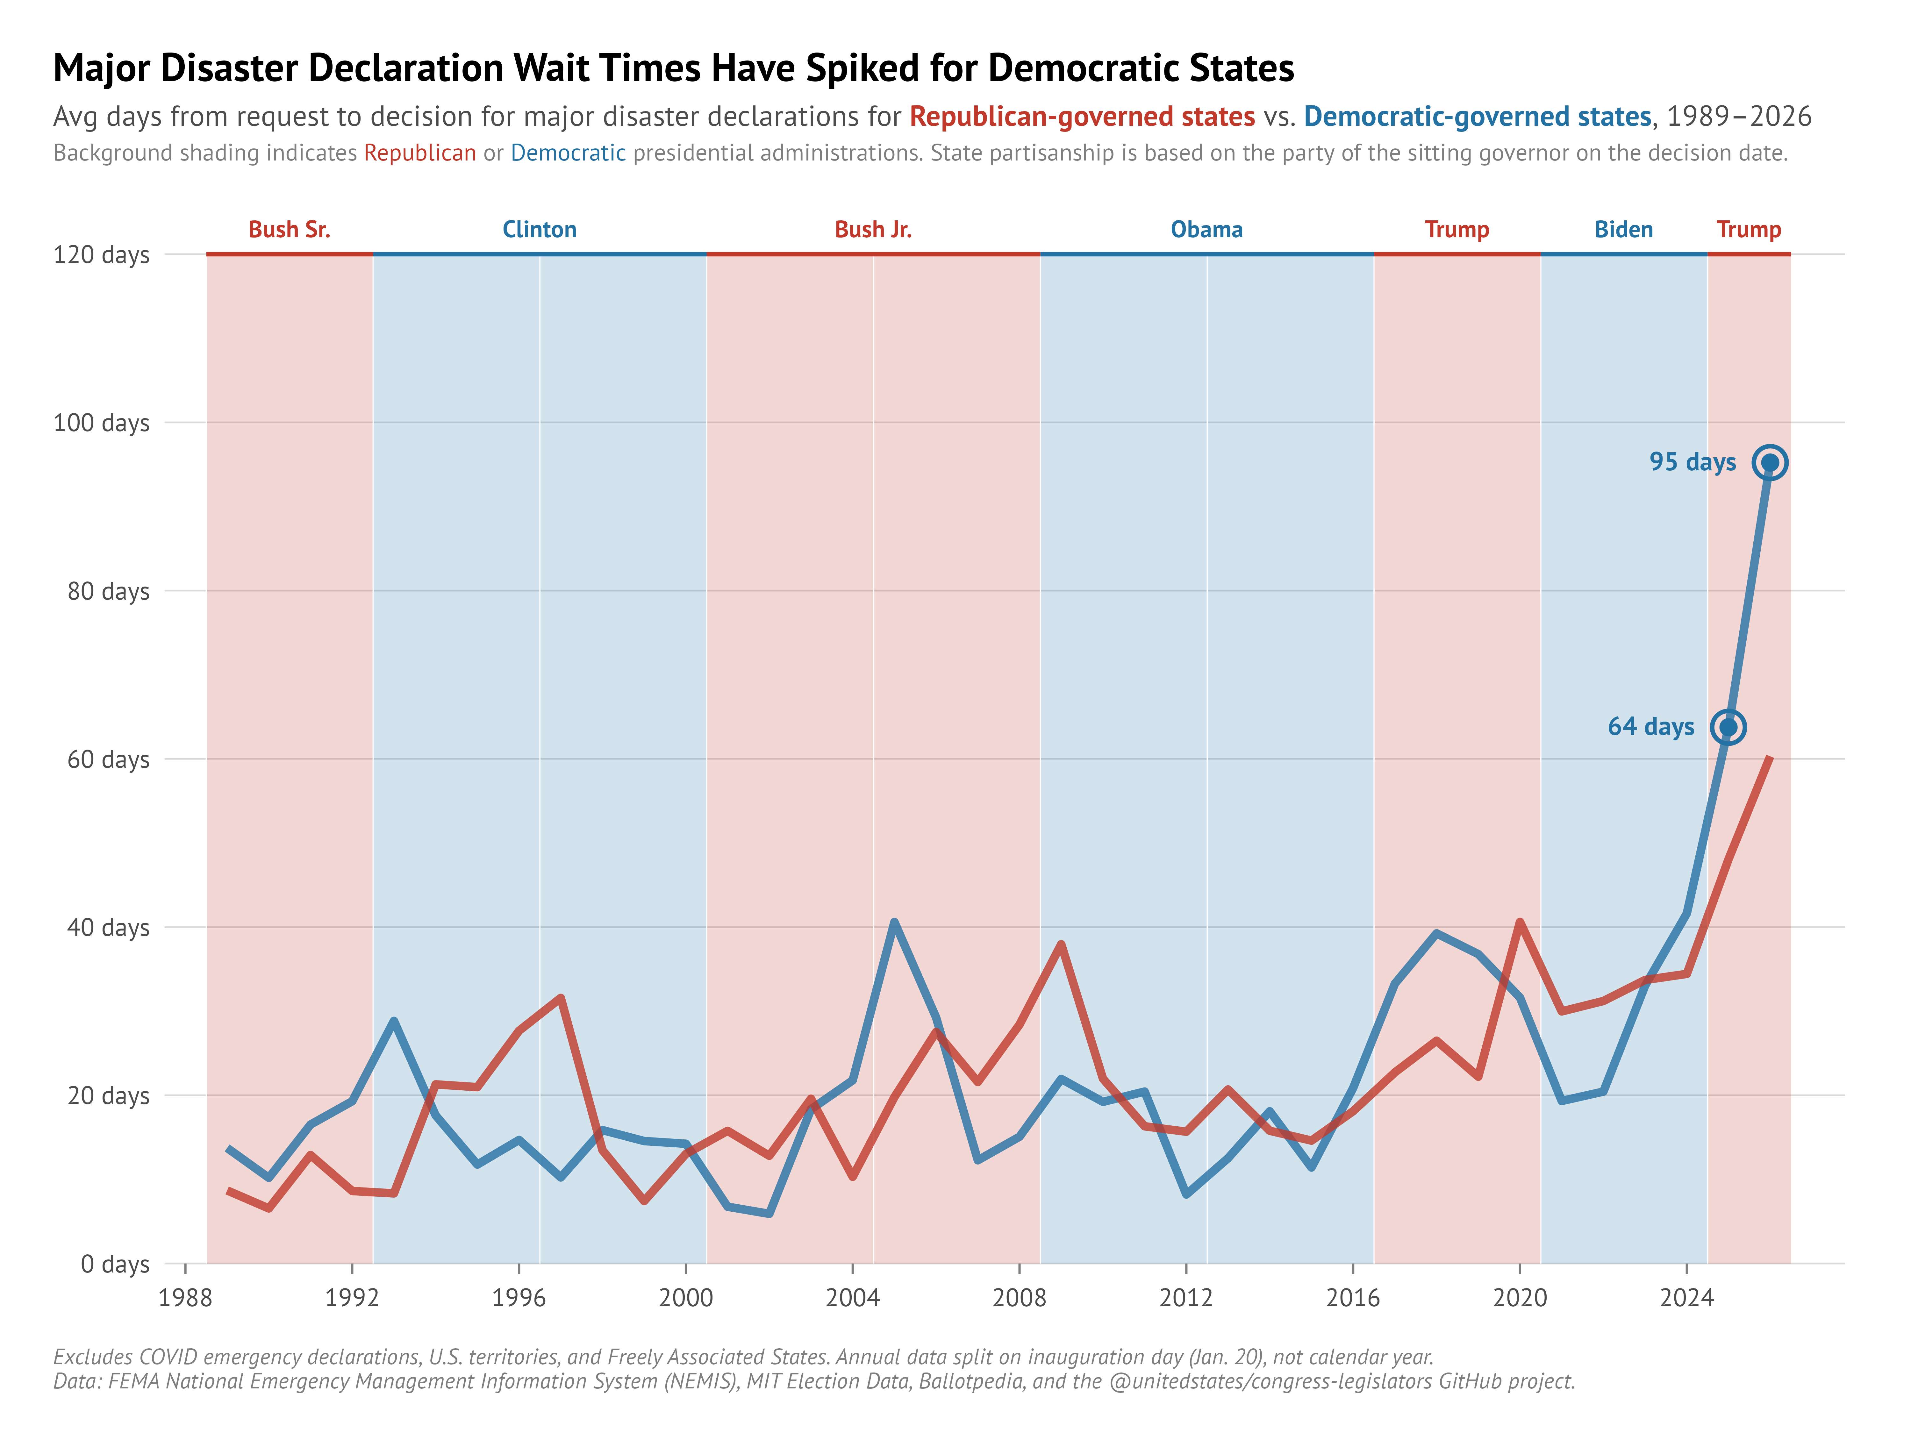
You can still see the change…

Slide 9
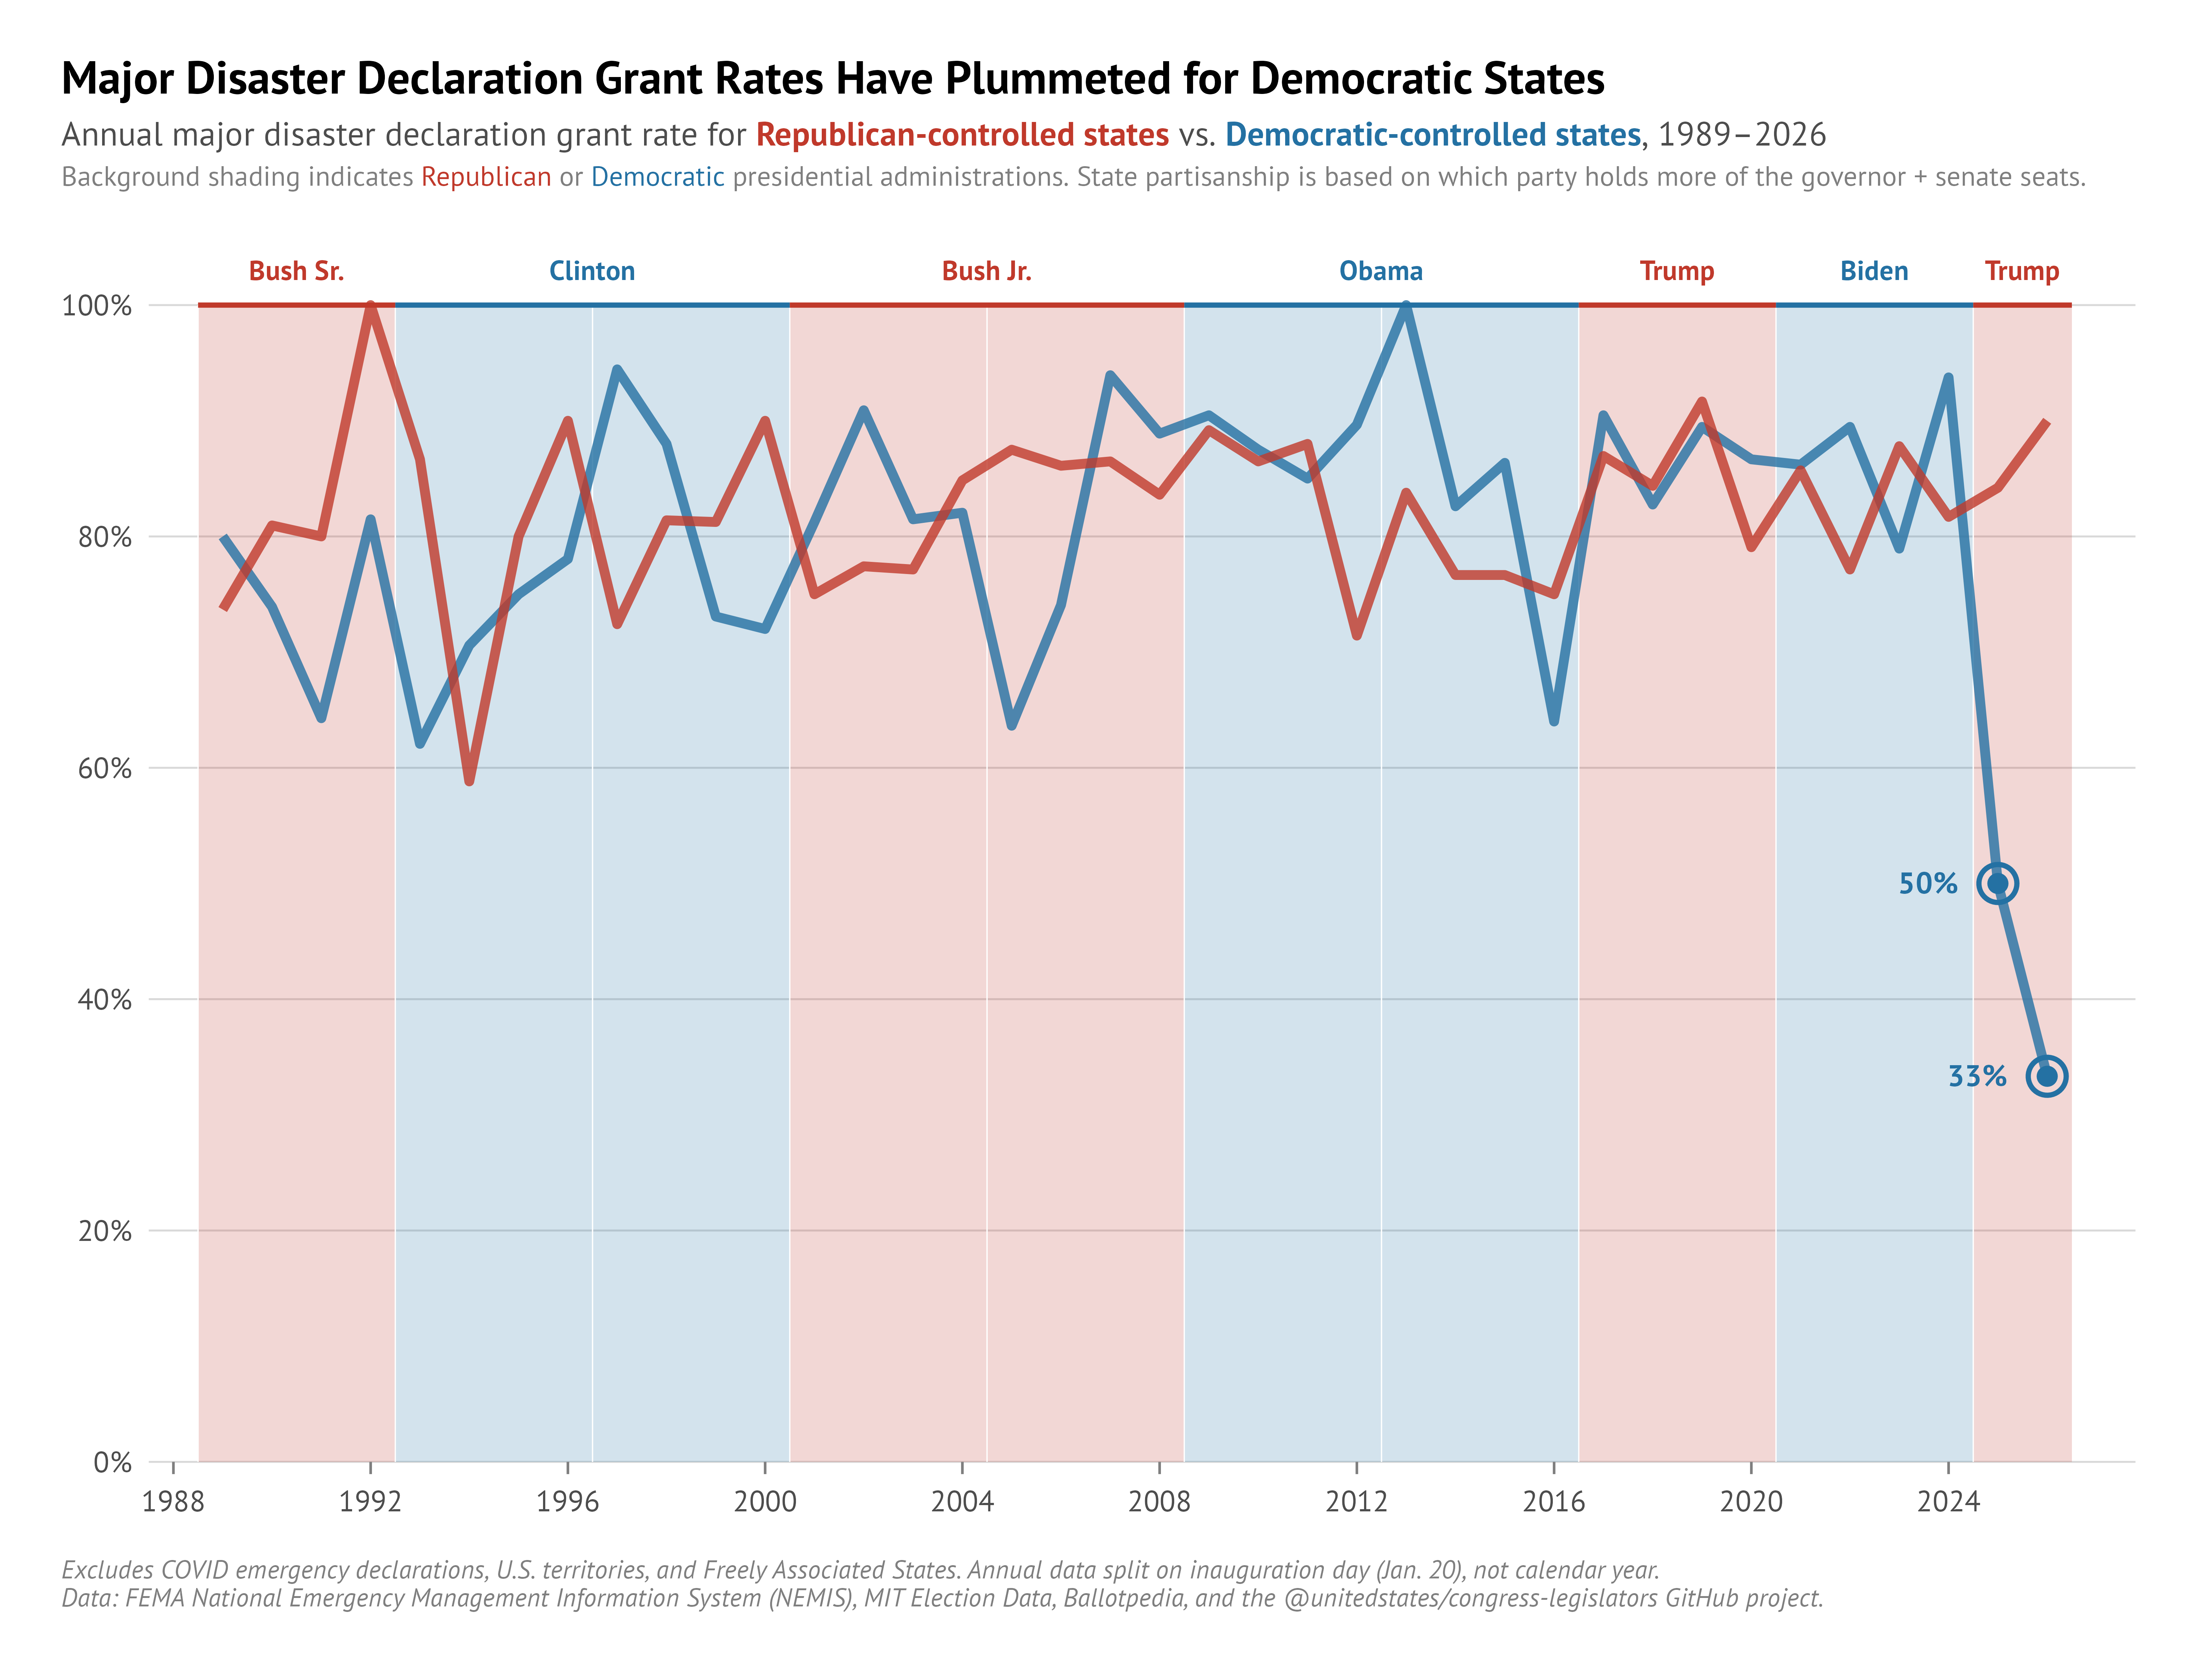
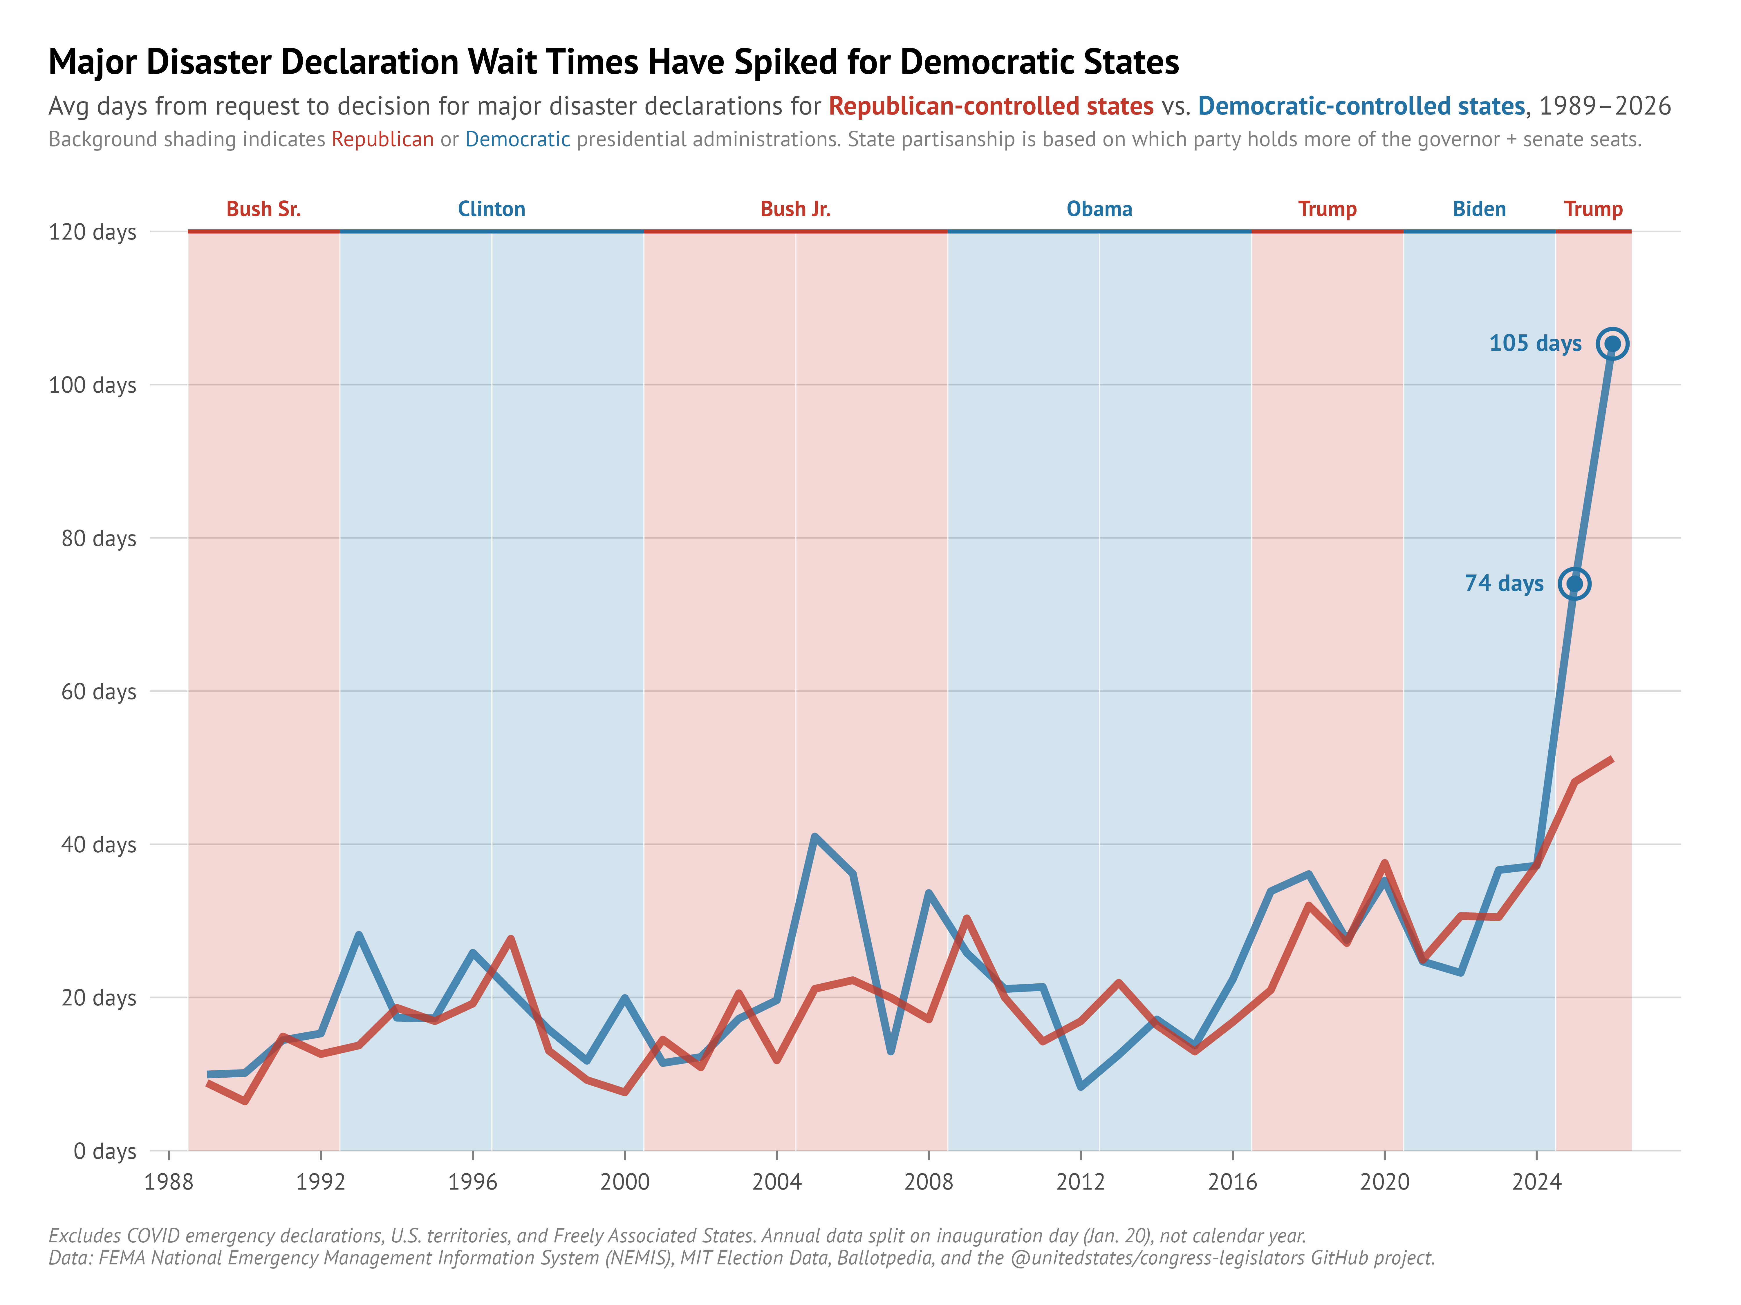
Yup, still there.

Slide 10
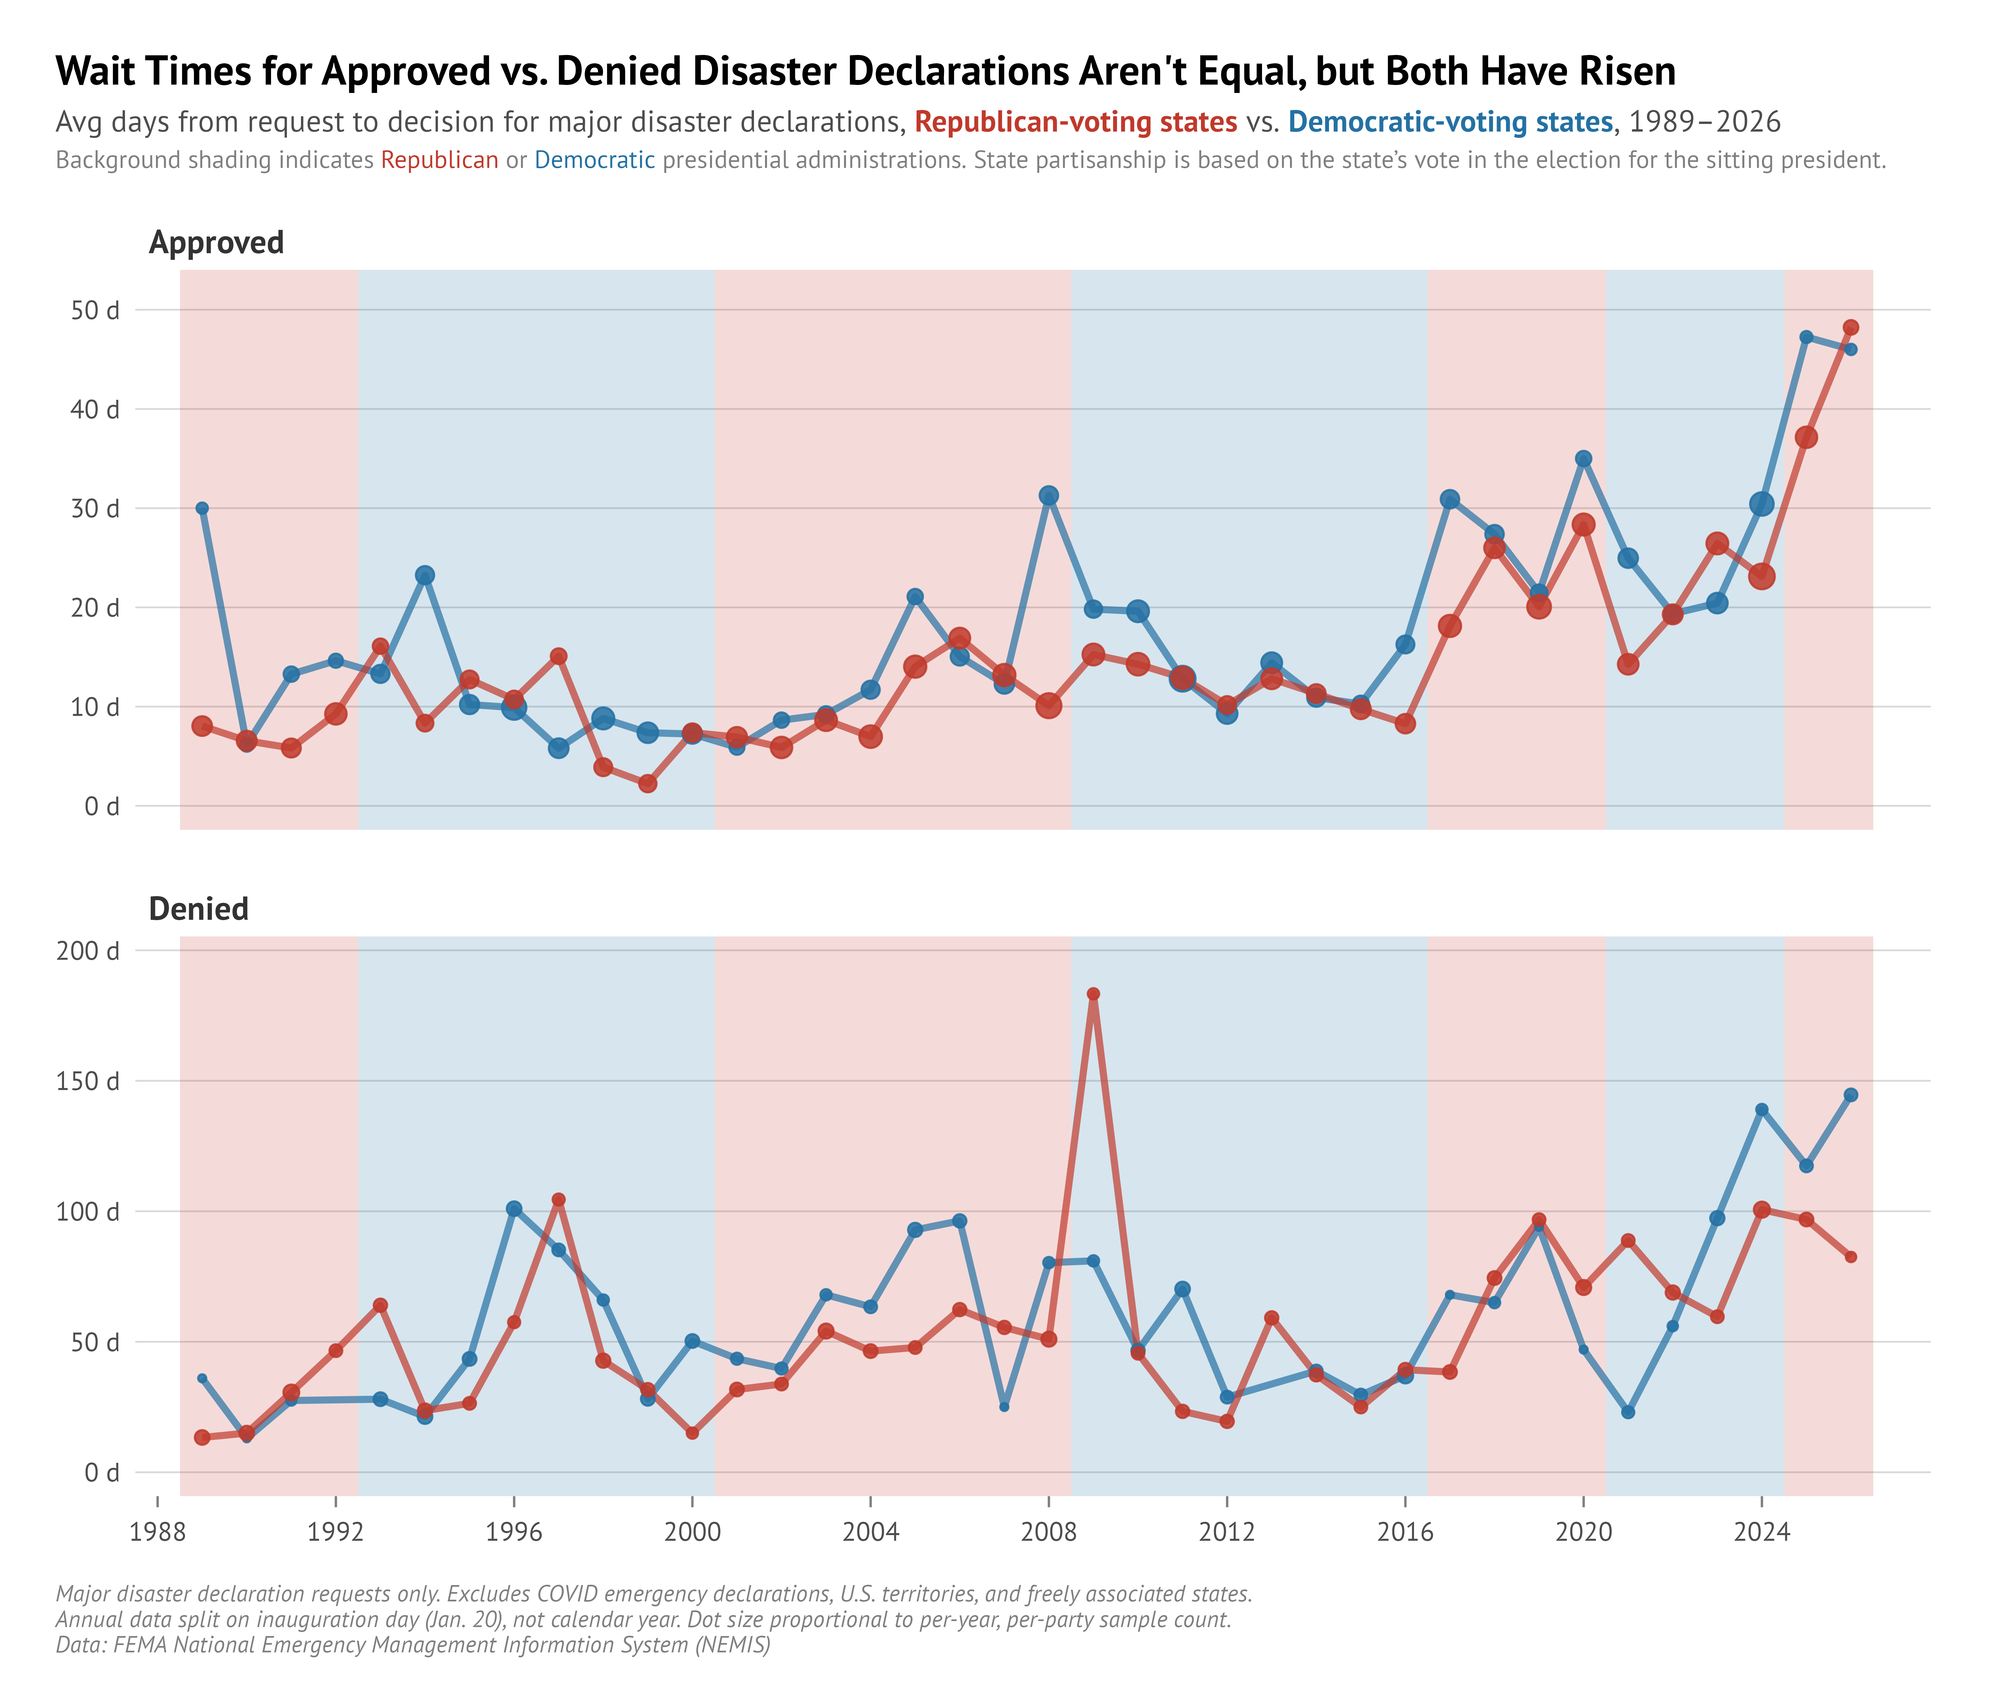
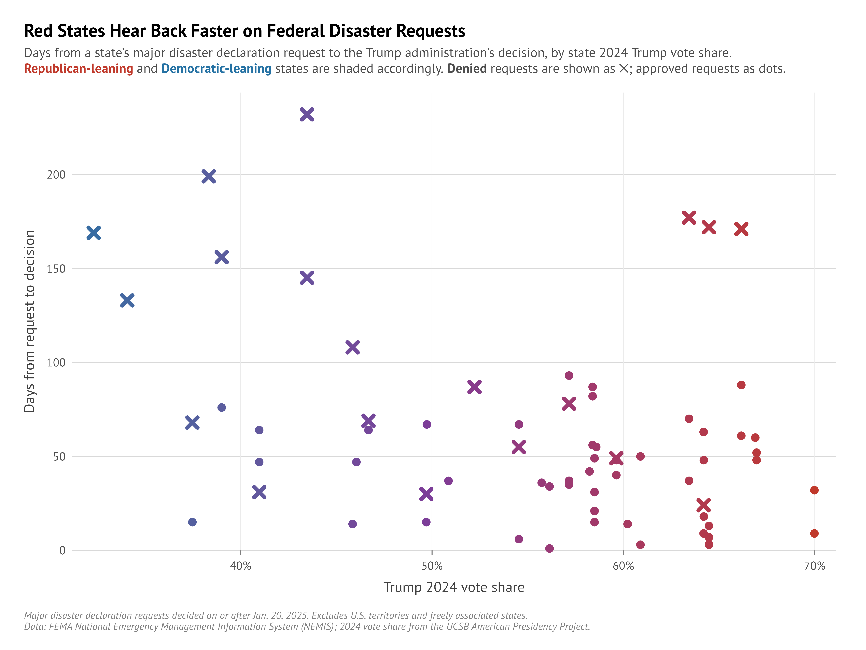
Just checking our work…

Slide 11
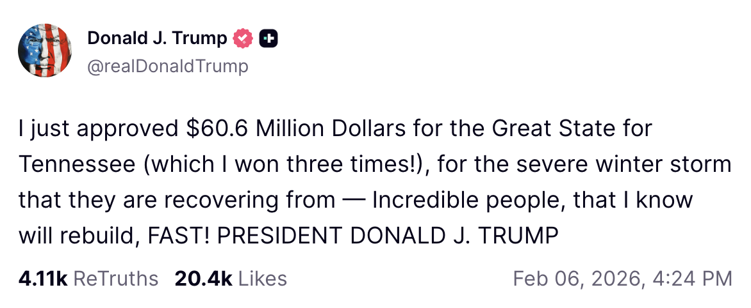
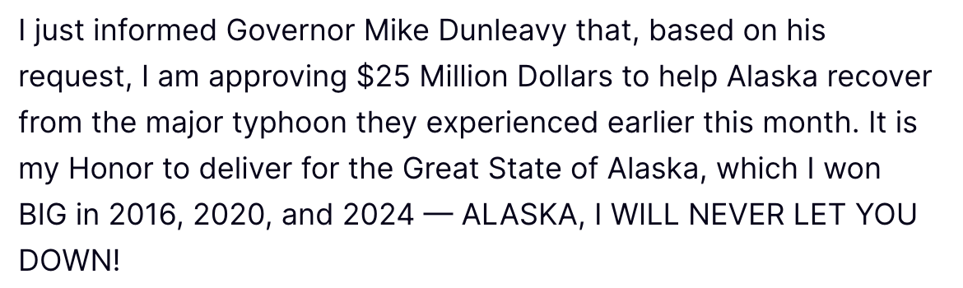
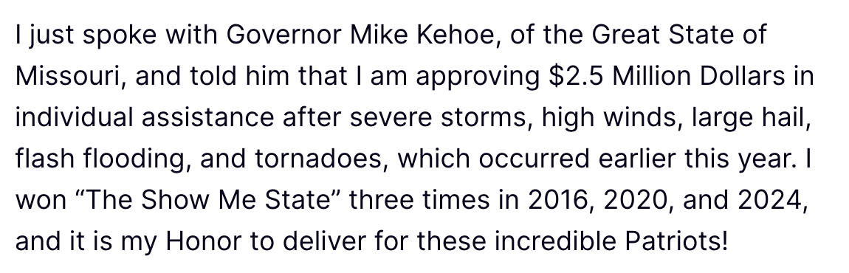
What changes should be made?
Cap the amount of time to respond—states already have a 30-day deadline to request and to appeal a rejection, making it reciprocal would be fair
Remove presidential discretion (by act of Congress) and codify specific thresholds for approval, e.g., a per capita damage amount in dollars, to remove subjectivity/discretion

